Slide 1
Ukrainian grammar against Slavic and typological background
Dmitri Sitchinava
Leipzig University / Helsinki university
mitrius@gmail.com

Slide 2
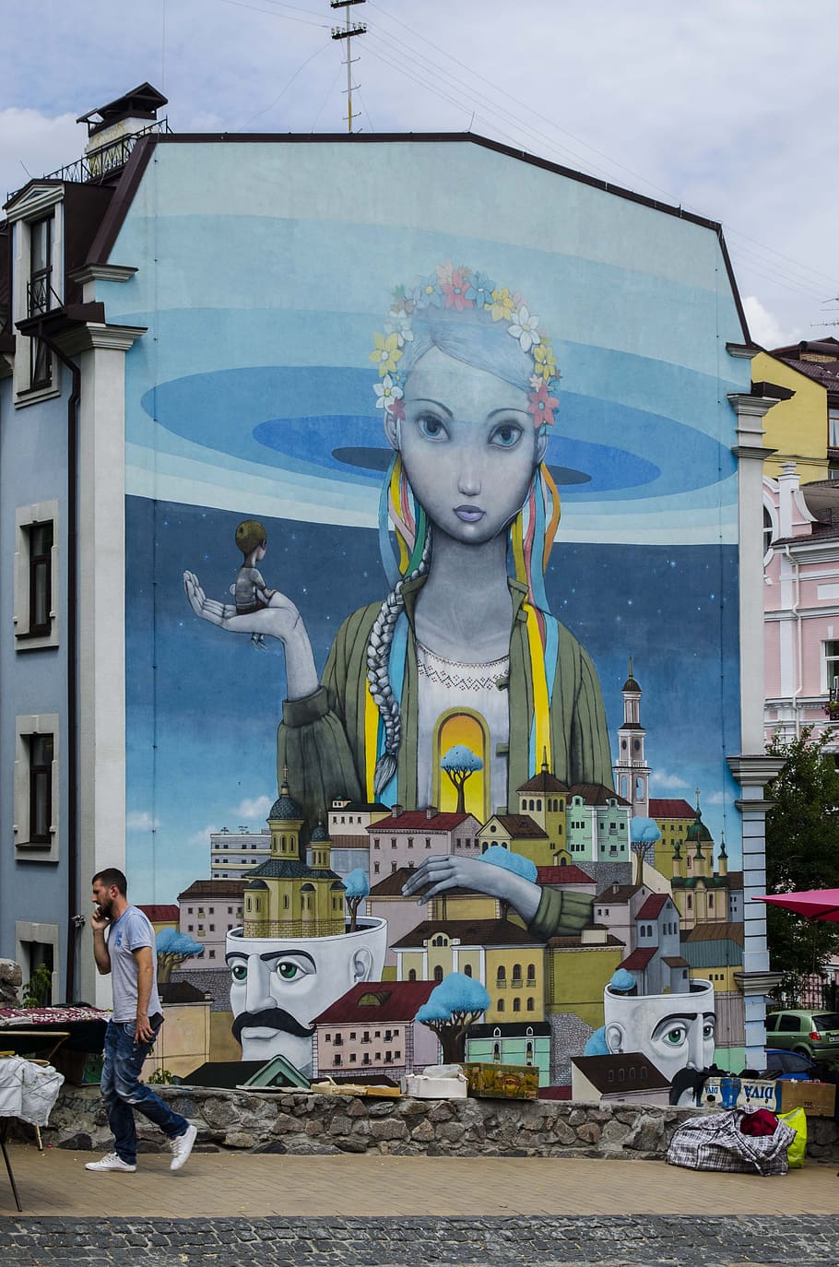
Ukrainian
An East Slavic language
The official state language of Ukraine
The native language of about 40 million people
The third most spoken Slavic language after Russian and Polish

Slide 3
Ukrainian
Descendant of Old East Slavic (called also davnjo-rus’-kyj old-Rus’-ADJ < rus’kyj from Rus’ not Russia; Old Russian, Altrussisch are [at least after 1917] misleading)
A language sharing typological features with most Slavic languages
«free» word order with SVO unmarked; word order is typically topic/focus-marking;
7 cases and 3 genders;
no articles;
Slavic-type aspect (lexical feature) as a pivot verbal category; preverbs marking Perfective;
Future for Perfectives formed as a morphological Present; Past (<Perfect) is a morphological participle with no person marking but agreed in gender
(NB Bulgarian and Macedonian depart from the Slavic standard in that they have articles and a more rich inventory of tenses and lack cases)

Slide 4
Ukrainian
Archaisms absent in Russian / Belarusian, to cite but a few:
no vowel reduction;
no final devocing;
archaic word stress paradigms;
positional vs. phonological palatalization of consonants
analytic future with TAKE rather than BE;
dual number (in dialects)
Innovations, including contact-induced (dax „roof“, čekaty na kohos’ wait on smb.-ACC < warten auf wait on; Polish; Russian; other)
NB high degree of variation even in the standard language!

Slide 5
In focus in this talk
Grammar (rather than phonology and lexicon)
Typological and areal context
Corpus-based research
Regional norms and regional distribution (see next talk)

Slide 6
General regionally annotated corpus of Ukrainian (GRAC): uacorpus.org - 860 M tokens, >100000 texts - 1816-2021 - morphological annotation - regional annotation (85%) - genres and style Maria Shvedova, Ruprecht von Waldenfels, Sergei Yarygin, Andrii Rysin, Vasyl Starko, Tymofij Nikolaenko (2017-2022) Kyiv, Jena

Slide 8
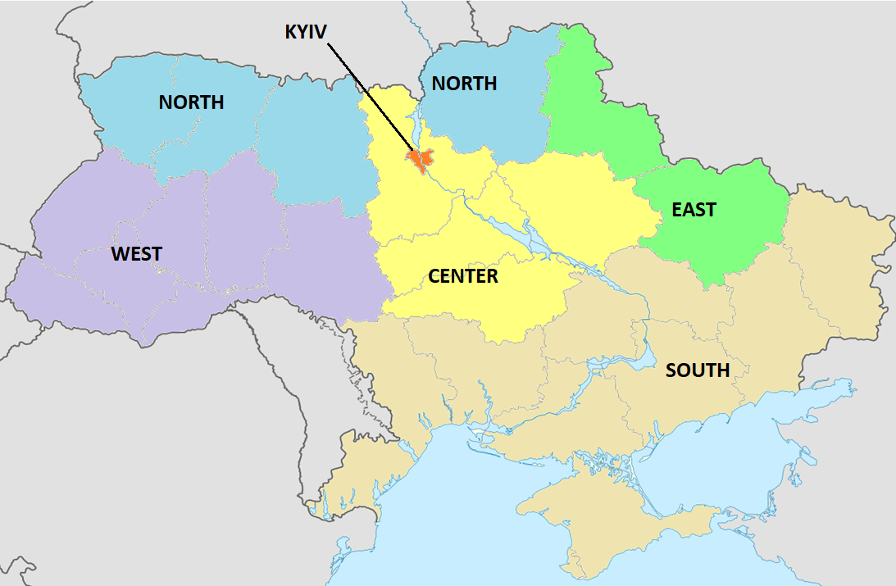
Regional annotation of GRAC

Slide 9
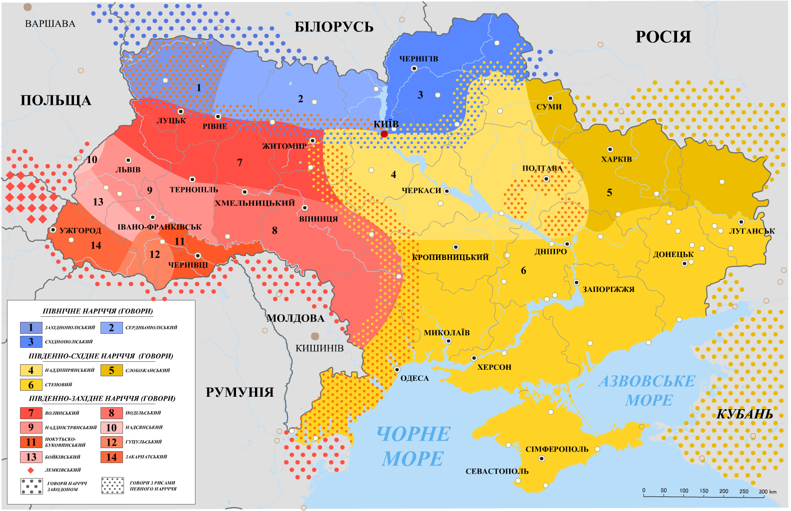
Ukrainian dialectal groups

Slide 10
Passive-like impersonal construction with accusative object
bulo vidpravlen-o ekspedycij-u be.PST.N send.PTCP.IMPERS expedition.ACC
NB as in Polish and Slovene: a separate category of impersonal -o vs. neuter (used in passives) -e (povidomlennja vidpravlen-e notification-NOM send.PTCP.PASS-N), a split of Old East Slavic *o neuter.
Passive vs. impersonal outside Slavic: Finnic, Celtic

Slide 11
Passive-like impersonal construction with accusative object
NB a regular passive bul-a vidpravlen-a ekspedycij-a be.PST.F send.PTCP.PASS.F expedition.NOM is also correct (and the only option in Russian)
Analogues in Polish: Zbudowan-o szkoł-ę (built-PTCP.IMPERS school-ACC) ‛a school was built’
Northern Russian dialects: kuplen-o korov-u (bought-PTCP.PASS cow-ACC) ‛a cow was bought’
V. Plungian: «lazy Passive» (without a syntactical raising of the object). Note that the Polish and Ukrainian constructions are not technically Passive (whereas the Northern Russian is)

Slide 12
Passive-like impersonal construction with accusative object
j-oho vbyt-o he.ACC kill.PTCP.PASS-IMPERS
a. ‛he is killed’ (recently, hot news perfect)
b. ‛he (was) killed’ (say, in 1950, in a narrative)
j-oho bul-o vbyt-o he.ACC be-PST-N kill.PTCP.PASS-IMPERS
only b. reading
NB zero copula (=present copula in Slavic) does not imply perfect-resultative.
Cf. Latin mortuus est dead be-PRS ‛he died’
obsolete Russian (1830s) Moskva… francuzu otdana Moscow Frenchman.DAT given-PTCP.PASS.FEM lit. ‛Moscow is surrendered to the French’ (the intended meaning that it was surrendered, but since evacuated)

Slide 13
West (orange) vs. East & Kyiv (blue)

Slide 14
Active participles
NB less frequent use in Ukrainian of the active participles (such as kerujučyj ‘govern.PTCP’) perceived often as Church Slavonic or Russian-influenced
In Slavic, active participles are prone to function as single attributes or in a relative clause (Shagal 2019), rather than in converb or predicate constructions

Slide 15
-Jaščij/-juščij active participles
Deriving from Church Slavonic with its characteristic feature of -šč- instead of East Slavic cognate -č-
Standard Ukrainian and Belarusian avoid them (as does spoken Russian) in favor of relatives: U toj, ščo… ‘the one that…’, B jaki… ‘which…’ even in single attribute contexts
NB even the inherited ES participial active forms (-č- PRS.PTCP and -š- PST.PTCP) are avoided as ‘too Russian’ syntactically save some lexicalizations (studied by M. Švedova 2020) in single attribute (not relative clause) contexts

Slide 16
Early Standard Ukrainian: both SA and REL
pro-jiždž-aj-ušč-ij
through-drive-IPFV-PTCP.PRS.ACT-M.SG
‘even when a traveller-by enters, he would chase everybody out’ (Kvitka-Osnovjanenko, Eastern Ukraine, 1838) Single attribute
dopik-aju-šč-ij
annoy-IPFV-PTCP.PRS.ACT-M.SG
‘annoying whiff of the northern wind and troubling frosts’
(Antin Mohylnyc’kyj, Western Ukraine, 1851) Single attribute
ljubj-a-šč-ij
love-IPFV-PTCP.PRS.ACT-M.SG
‘Thank God, I am now healthy and merry and sincerely loving you, my only friend’ (Shevchenko, 1857) Relative

Slide 17
Relatives: PTCP > Finite
rod-ju-šč-ij [Kulish, Puljuj 1868-1904]
give.birth-IPFV-PTCP.PRS.ACT-M.NOM.SG
ščo vono roz-siv-a-je [Ohijenko 1950-1960s]
REL it PVB-give.seeds-IPFV-PRS.3.SG
and every tree, in the which is the fruit of a tree yielding seed; to you it shall be for meat [Bible KJV]

Slide 18
SA Participles > Adjectives
Lexicalized adjectives that made part of Modern Ukrainian:
NB ecclesiastical semantics vsjudy-su-ščyj everywhere-be-PTCP ‘omnipresent’, hrjadu-ščyj go-PTCP ‘forthcoming’ (< participle of exclusively Church Slavonic grjasti ‘go, come’; now associated with Rus. grjadu-ščij and is stigmatized)
Four variants of ‘all-seing’ in the Ukrainian Academic Dictionary:
vse-vidju-ščyj, vse-vidja-ščyj, vse-vidja-čyj, vse-vidju-čyj all-see-PTCP (with no evident diachronical distribution)
Non-ecclesiactical lexicon
Pid-xodja-ščyj PVB-go-PTCP ‘suitable, appropriate’, ne-v-myru-ščyj NEG-PVB-die-PTCP ‘immortal’, kryču-ščyj shout-PTCP ‘blatant’, lit. ‘shouting’ (cf. Rus. podxodjaščij, kričaščij)

Slide 19
DOM
Differential object marking (cf. papers in the collection Witzlack-Makarevich, Seržant (eds.). Diachrony of differential argument marking, Berlin 2018)
Russian or Spanish animacy:
vižu stol / malčika / psa
see.1SG table-ACC=NOM boy-ACC=GEN dog-ACC=GEN
I see a table / a boy / a dog
veo una casa / a una mujer
see.1sg INDEF.F.SG house / PR INDEF.F.SG woman
I see a house / a woman
Polish and Slovak (dialectal) male-personal category (male humans are coded separately)
Early East Slavic personal category (before expanding to the names of animals)
Definiteness/specificity hierarchies (in Turkic) etc.

Slide 20
Slavic -a-masculine beyond animacy
Polish:
widzę papiros-a
see.1sg cigarette-ACC=GEN
mam mercedes-a
have.1sg Mercedes-ACC=GEN
Dialectal and popular (Karas 1979, Banko 2001, Stefanczyk 2007), often rejected by educated speakers
Swan 2002: «mental states; hits and kisses; cars; cigarettes; trademarks; dances; money; plays; gestures; mushrooms; garbage; wine; fruits; varia»

Slide 21
Ukrainian accusative -a stemming from genitive
Semantic classes include body parts, clothings, money, mechanisms and tools
Kapeljux ‘hat’ 70%, spis ‘lance’ 50%, NB hryb ‘mushroom’ 31%
Money: 37% for karbovanec’ ‘Imperial and Soviet rouble’, but 4% for dolar
Some other semantic groups previously favoring -a such as “days and months” or “trees” shrink its use since the beginning of the 20th century
Does this suggest an overall diachronical decline?

Slide 22
Ukrainian accusative -a stemming from genitive
Productiveness: with new lexemes as smartfon-a ‘smartphone’, teploxod-a ‘motor ship’, tomahavk-a ‘tomahawk’, tjubik-a ‘squeeze tube’
“Phraseologisation”
prykusyty jazyk-a lit. ‘bite tongue-GEN’ (‘to stop talking’) parallel to
Russian prikusit’ yazyk with zero-marked ACC=NOM.INAN; some other phraseological units (vterty nosa wipe nose-ACC=GEN, ‘to have it, competing with an opponent’)
Fiction after 1990: ipm increases from 55,5 to 66,9 (exact Fisher test p< 0.00001)

Slide 23
Body parts
Gen-like form Widespread in Ukrainian but marginal in Polish
For Polish palec ‘finger’ and ząb ‘tooth’ the a-form ratio (NKJP) is about 2%-3%, but 24% and 86% for their Ukrainian cognates palec’ ‘finger’ and zub ‘tooth’
Unattested for other Polish names of body parts

Slide 24
Pluperfect
vin pysav buv
he write-PST be-PST
‛he had written’

Slide 25
Supercompound forms
Based on a compound Perfect form (HAVE or BE + participle)
The auxiliary is itself in compound Perfect > 2 auxiliaries
Il est venu > il a été venu (standard French, dialects; Franco-Provençal)
Ich habe gelesen > ich habe gelesen gehabt (colloquial)
NB a uniformed « auxiliary of shift » in some languages with HAVE/BE auxiliary choice (Franco-Provençal, Yiddish)
Pluperfects as “discontinuous past” (Plungian, Auwera 2006): cancelled results, frame past, irreals etc.

Slide 26
Supercompounds
Without typological generalizations until 1980s
Holtus 1995 on Romance
Litvinov, Radčenko 1998 about German with parallels
Buchwald-Wargenau 2012 – German (diachrony)
Gilbert Lazard 1996 – surcomposé on Iranic
Lewin-Steinmann 2004 – Bulgarian and German
Petrukhin et Sitchinava, 2006+ -- Slavic forms
Europe mainly Romance & Germanic: Ammann 2005; Schaden 2009; L. De Saussure, Sthioul 2012

Slide 27
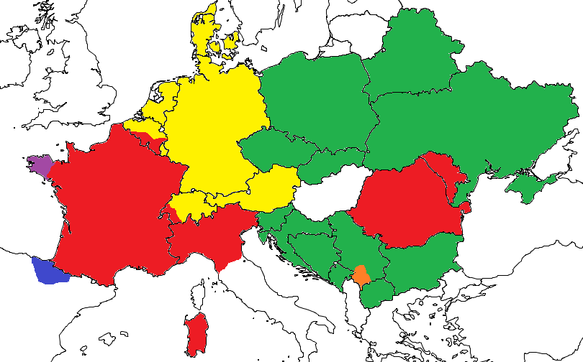
Areal distribution in Europe

Slide 28
Pluperfect: Diachronical dimension
Decline of the frequencies of the (non-standard) Ukrainian Pluperfect in fiction (other than counterparts of bylo, and even these) towards the later Soviet period (100 > 60 ipm, only fiction)
Revival with some Post-Soviet authors

Slide 29
Lexical frequency list of the Ukrainian pluperfect
xotity ‘want’ ~ as with Russian bylo invariable particle (abnormal situation, Barentsen 1986, Kagan 2011 etc.)
xoti-v bu-v want-PST be-PST ‘I wanted to P, but did not P or did not finish it’
počaty ‘start’ ~ R. (‘I started, but stopped’), cancelled result
sprobyvaty ‘try’ ~ R. (‘I tried, but failed’)
kynutysja ‘precipitate, reach, jump’ ~ R.

Slide 30
Lexical frequency list of the Ukrainian pluperfect
…
musity ‘to have to’ !=R.
mohty ‘to be able to’ !=R.
maty ‘to have to’ !=R.
NB! NOT ONLY WESTERN USES, all the regions of Ukraine
vin musyv buv he must-PST be-PST ‘he should have to do smth, but failed to do so’ (irreal)

Slide 31
Ukrainian futures
Old East Slavic Future (I)
Auxiliary jati ‛take’ (not to be confused with iměti ‛have’) further grammaticalizing as a morpheme:
pysaty-mu
‘write.INF-take.1SG’
‘I will write’
Only for imperfective aspect (PF.PRS = FUT)
cf. Romance: French j’écrir-ai I write.INF FUT.1SG < Latin scribere habeo write.INF have.1SG
NB Old East Slavic archaism lost in Belarusian and Russian + innovation unique for Slavic
NB budu pysaty be.FUT write.INF construction is also present, common with Russian and Belarusian (and borrowed from 16-century Polish)

Slide 32
Ukrainian futures
Future anterior (II)
characteristic for the Western dialects
drifting in the 19th-20th centuries towards the future imperfective marker not unlike in Polish (budu spala ‘be.FUT.1SG sleep.PST.PARTC.SG.F’ ‛I will have slept’ > ‘I will sleep’) with some specific modal uses

Slide 33
FP > FUT
In Polish, the historical Slavic Future Perfect construction has grammaticalized into a marker of (imperfective) future: będzie robił be-FUT do-PST.M ‘he will do’
Historically Polish (now dialectal) be-FUT + inf. > Russian budet delat’ be-FUT do-INF ‘he will do’
This development is also known in Slovene, some Čakavian variaties of BCMS and, typologically, in Greek and Romance
Lat. cantavero sing.2FUT.1.SG > Dalm. kantuóra sing.FUT.1.SG

Slide 34
FP > FUT
In recent Pen’kova’s works that present a wide-scale typological account of Future Perfects and their secondary non-compositional meanings, this shift is described as a generalization of the conditional meaning (Pen’kova 2018).

Slide 35
GRAC
NB only contact constructions:
[lemma="бути" & tag=".*futr.*"] [tag=".*past.*" & tag!=".*noun.*" & tag!=".*adv.*"]
NB the postposition of AUX is not attested

Slide 36
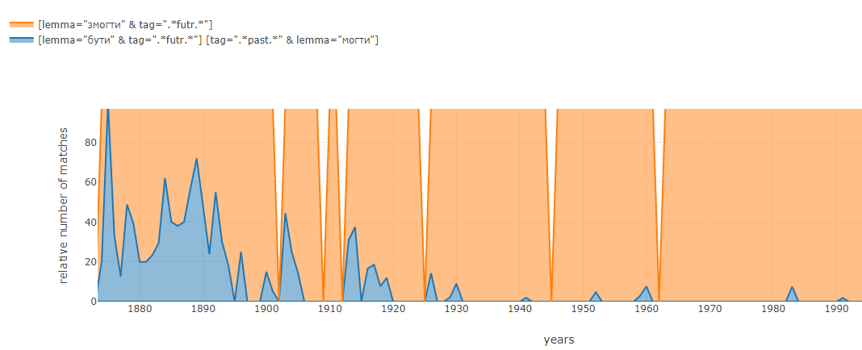
Be able.FUT: budu mih (IPFV) vs. zmožu (PRS.PFV) (only in the West)

Slide 37
2FUT vs. budu+INF (=Central and Eastern & as in Russian; but counted only in the West)

Slide 38
Lexical analysis
The most frequent verbs used with the FP are the modal verbs:
mohty ‘to be able’,
maty ‘to have to’ (but also just ‘have’),
musity ‘to be obliged’,
potrebuvaty ‘to need’, Western ‘to have to’,
znaty ‘to know’, Western ‘to be able’

Slide 39
Also featuring
prosyty ‘request’
robyty ‘make’
žyty ‘live’
staratysja ‘make effort’
jisty ‘eat’
hovoryty, kazaty ‘speak’
xodyty ‘walk’, stojaty ‘stand’, sydity ‘sit’, ležaty ‘lie’

Slide 40
Aspect
As it is the case in Polish, the verbs attested in this construction are overwhelmingly imperfective with very few earliest (19th-century) exceptions
budu kinčiv be.FUT.1SG finish.PST.M ‘I am about to finish’
the Biblical example [Leviticus 1, translated by Kulish and Puljuj]
bude pry-nis be.FUT.3SG PVB-bring.PST.M ‘he brought, offered’
And if the burnt sacrifice for his offering to the Lord be of fowls, then he shall bring his offering of turtledoves, or of young pigeons’

Slide 41
Condition
In the Biblical passage it signals a [non-temporal] precondition to a prescribed habitual situation, known also in Old East Slavic
Cf. the Russkaja Pravda (11 century) legalese passages:
Bud-etь li sta-lъ na razboi…
be.FUT-3.SG if stand/commit-PF.3.SG to murder.ACC.SG
‘In case one commits murder without a conflict, (other) people should not pay for the murderer’

Slide 42
If-clauses (in an non-temporal/future situation)
... bud-ut' praktik-uva-l-y v ukrajins'kіj movі
be.FUT-3PL practice-IPF-PST-PL in Ukrainian-LOC.SG.F language-LOC.SG
(Dilo, Lemberg/Lviv, 1913)
‘So after this performance the Dominican Fathers can fulfil their task and the Apostolic duties only (if and) when they hold public service in their churches in Ukrainian’

Slide 43
Temporal precedence
Rare:
Tіl'ky tomu , ščo ty bud-eš ljaskav po stolі?
only because that you be.FUT-2SG hit-PST.M on table.M.SG.LOC
(Jurij Vinnyčuk, Legends of L’viv)
‘I can bet for ten golden pieces that you will stand on the table and I will hit the table with my palm thrice, and you will immediately jump off the table. – Only because you will have hit the table? – the king laughed’

Slide 44
Questions
Other characteristic contexts for the FP are questions where the information about the prospective situation is incomplete (often in songs; xto bud-e kolysa-v? who be.FUT-3SG rock-PST.M‘who will rock the cradle?’):
Ano, de bud-em nočuva-l-y? (a folktale) so where be.FUT-1PL stay.overnight-PST-PL ‘So, where would we stay overnight?’,
Ščo bud-ete ji-l-y? what be.FUT-2PL eat-PST-PL ‘What are you going to eat?’
To hovor-y ščo. – Ta ščo bud-u hovory-l-a? then say-IMPER.2SG that PTCL FUT-1PL say-PST-F ‘Then, say something. – What would I say?’
Perhaps some point of reference is presupposed like ‘to be content later’

Slide 45
Politeness
‘Maybe it will be in the following way:’
bud-ete moh-l-y be.FUT-2PL be.able-PST- (I. Franko)
‘Hear, Mendel, will you be able to pay me all my money a week before?’

Slide 46
Politeness is also known for ES Pluperfect!
A different strategy: “understatement” (discontinuous past instead of actual present)
French: J’étais venu demander mes honoraires lit. I had come to receive my salary
Ja prišel-bylo I come-PST.M be.PST.N ‘I came to you to hear how I can become happy’ [Rus. 1780s]
— Ja xotiv buv bačyty pani. I want-PST.M be.PST.M see-INF lady-ACC ‘I would like to see the lady’ [Ukrainian, S. Vasyl’čenko, 1932]

Slide 47
Modality
Ukrainian FP is an instance of other semantic drift than in Polish, namely that of modality with future (and sometimes indefinite) time reference
Modalisation of future perfect described with much detail in Pen’kova 2018
Cf. among others presumptive uses:
Croatian (Čakavian):
Nieće se na biti izbudila još
NEG-FUT.3P.SG REFL she be-INF awaken-PST-F already
‘She must have been already awakened’
+Romance (aurai remarqué…), Lithuanian, Albanian and even the 19th-century English

Slide 48
Pluperfect
In some contexts it converges lexically and semantically with the Ukrainian Pluperfect (PPF)
It is also characterized, especially in the Western texts, by its frequent co-occurrence with modal verbs
Both the Pluperfect and Future Perfect make part of the tense paradigm of the modals.

Slide 49
Lexical frequency list of the Ukrainian future anterior
The most frequent verbs used with the FP are the modal verbs:
mohty ‘to be able’,
maty ‘to have to’ (but also just ‘have’),
musity ‘to be obliged’,
potrebuvaty ‘to need’, Western ‘to have to’,
znaty ‘to know’, Western ‘to be able’

Slide 50
Lexical frequency list of the Ukrainian future anterior
prosyty ‘request’
robyty ‘make’
žyty ‘live’
staratysja ‘make effort’
jisty ‘eat’
hovoryty, kazaty ‘speak’
xodyty ‘walk’, stojaty ‘stand’, sydity ‘sit’, ležaty ‘lie’

Slide 51
Lexical frequency list of the Ukrainian pluperfect
xotity ‘want’ ~ as with Russian bylo invariable particle (abnormal situation, Barentsen 1986, Kagan 2011 etc.)
xoti-v bu-v want-PST be-PST ‘I wanted to P, but did not P or did not finish it’
počaty ‘start’ ~ R. (‘I started, but stopped’), cancelled result
sprobyvaty ‘try’ ~ R. (‘I tried, but failed’)
kynutysja ‘precipitate, reach, jump’ ~ R.

Slide 52
Lexical frequency list of the Ukrainian pluperfect
…
musity ‘to have to’ !=R.
mohty ‘to be able to’ !=R.
maty ‘to have to’ !=R.
NB! NOT ONLY WESTERN USES, all the regions of Ukraine
vin musyv buv he must-PST be-PST ‘he should have to do smth, but failed to do so’ (irreal)

Slide 53
Thank you! The many variants of ADV + Thank you
grechno / krasno / krasnen’ko / uklinno djakuju
More on variation in Ukrainian after a break

