Slide 1
13 December 2023
War, Language and Culture
Changes in cultural and linguistic attitudes in education and culture in central Ukraine after February 24, 2022
Olena Pchelintseva
Cherkasy State Technological University, Cherkasy, Ukraine
Johannes-Gutenberg-Universität; Institut für Slavistik, Turkologie und zirkumbaltische Studien, Mainz, Germany

Slide 2
Problem Statement
Methods
Research results (2022)
Research results (2023)
Conclusions

Slide 3
The status of the Ukrainian language as a state language and the unity of the Ukrainian cultural space, the consolidation and development of the Ukrainian nation, its historical consciousness, traditions, and culture were established by the Constitution in 1996.
BUT:
The conditions and dynamics of the Ukrainian language status and socio-cultural situation in the period after 1991 did not correspond to the provisions stipulated by the Constitution
(much more detail, information, figures, and documents have been described and analysed in a number of sociolinguistic and cultural studies (Taranenko 2010; Shapoval 2008; Paton 2011; Masenko 2018; Pekar and Rashkovan 2022).
«The Ukrainian ethnic group is still mentally fragmented, regional forms of mentality dominate the national ones. All-Ukrainian identity is still in the process of its formation»
Рудакевич 1995, с. 30; Ковальська-Павелко 2019, с. 239.

Slide 4
Components of the national mentality :
peacefulness, tolerance, slow reaction to offence, caution, conformism
Козлова 2014, Ковальська-Павелко 2019
“Do you agree with the statement that there is a language conflict in Ukraine?”
47,9% - “rather no” and “do not agree at all”
23,3% - “both yes and no”
20,7% - “rather yes” and “completely agree”
2017, Project Volkswagen,

Slide 5
The number of respondents who mentioned
Russian as their native language
Cherkasy, Ukraine
2006
28%
2016
9%
2023
2,2%

Slide 6
Use of Ukrainian in social media (studends)
2016
60%
2022
76%

Slide 7
Use of Ukrainian in professional discourse
2006
58%
2016
71%
2022
91%

Slide 8
The Law “On Ensuring the Functioning of the Ukrainian Language as the State Language” 2019
Mandatory examination for civil servants on the official language proficiency with a carefully designed system of assessment criteria to attain reliable results,
transition of all Ukrainian schools (starting from the 1st class) to the Ukrainian language,
strict requirements on outdoor advertising,
obligatory (and controlled) requirement to serve buyers and clients in Ukrainian language
etc.

Slide 9
What Ukraine has not achieved by means of its language policy in 30 years, Russia has provoked by attacking its neighbour. This full-scale war is promoting a change in language. Using Ukrainian is the order of the day, for Ukrainian is the language of the resistance.
V. Kulyk 2022
Die Sprache des Widerstands. Der Krieg und der Aufschwung des Ukrainischen. Osteuropa 6–8. 237–248. https://zeitschrift-osteuropa.de/hefte/2022/6-8/die-sprache-des-widerstands/english

Slide 10
On February 28, 2022, at 14:45, the State Agency of Ukraine for Art and Art Education published the document “Demand for Cultural Sanctions Against the Russian Federation” on its official website. Demand for cultural sanctions against the Russian Federation. 28.02.2022 https://www.kmu.gov.ua/news/vimoga-kulturnih-sankcij-shchodo-rosijskoyi-federaciyi
The main message verbalized by this document is the “toxicity” of the Russian culture and a call to reject the Russian cultural product
«cancelled Russian culture»
«відмова від російської культури»

Slide 11
Vakhtang Kebuladze, philosopher, writer, interview to Forbes 08.08.2022:
I hope that the majority of our fellow citizens will finally understand that Russia is evil. That sentiment for Russian culture, art, literature or the country as a whole, if any, will persist only among a few. And this is also the moment of truth: Russia is not only our enemy, but the enemy of all mankind, it brings death to the world.(...) Russians cannot be cured by forcing them to read Pushkin – on the contrary, it will aggravate the disease. Pushkin is also a symptom of the disease, there is nothing to cling to (...).
I advise everyone who wants to understand what Russia is to read “Shatuny” by Yuri Mamleev and “Nastya” by Vladimir Sorokin. It is a disaster and a living hell. It is enjoying own degradation. And this is what Russia really is
https://forbes.ua/lifestyle/viyna-zhakhliviy-ale-potuzhniy-psikhoterapevt-yak-dosvid-smerti-zminyue-ukraintsiv-a-spilna-travma-zshivae-krainu-intervyu-z-filosofom-vakhtangom-kebuladze

Slide 12
Department Meeting
Ukrainian Language and General Linguistics
No. 7
April 10, 2022.

Slide 13
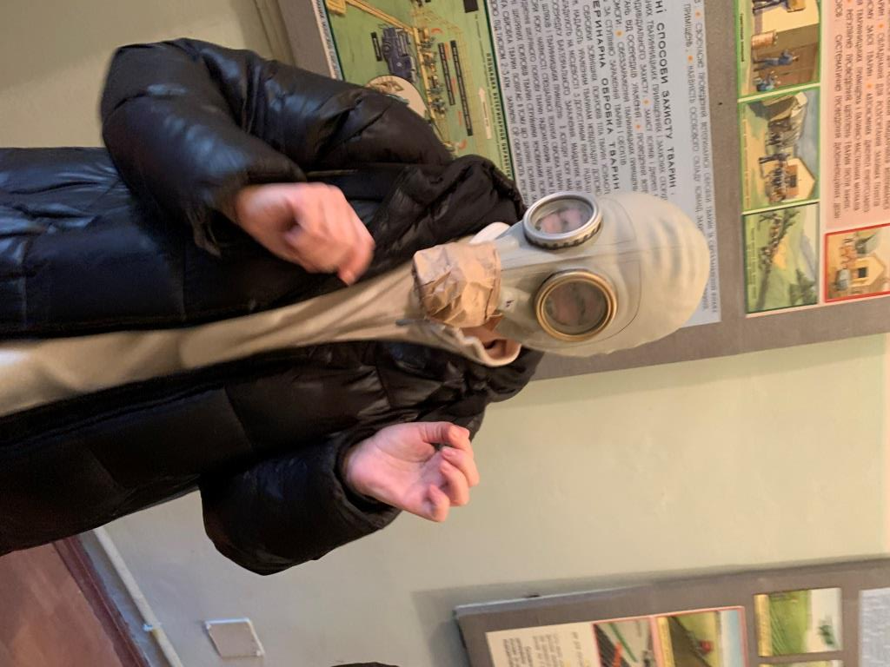

Slide 14
Засідання кафедри
української мови та загального мовознавства
Протокол № 7
10 квітня 2022.
Порядок денний:
Інструктаж з техніки безпеки
Отримання протигазів
Підготовка до Днів студентської
науки 2022
Різне
Department Meeting
Ukrainian Language and General Linguistics
Protocol No. 7
April 10, 2022.
Agenda:
Safety briefing
Distribution of gas masks
Preparation for the Student Science Days 2022
Other Matters

Slide 15
Internet Survey July – September 2022
The number of respondents was 100 people
Teachers at universities and technical schools, secondary school teachers, museum and library workers, representatives of theatrical art, and writers
Cherkassy, Kiev, Poltava, Kirovograd
«The scientific community is a collective subject of language policy. It forms the opinion of the expert environment, articulates the language ideology»
Bogdan Azhniuk,
director of the Oleksandr Potebna Institute of Linguistics of the National Academy of Sciences of Ukraine and the Ukrainian Bureau of Linguistic Expertise of the National Academy of Sciences of Ukraine, 2022

Slide 16
Internet Survey July – September 2022
The gender distribution
women – 79, men – 21
(according to the Main Department of Statistics of Kiev (2019–2020), about 75% of women are involved in education, about 72% of women are employed in museums, libraries, and other cultural institutions)
The age distribution
19–25 years old – 6%,
26–40 years old – 21%,
41–59 years old – 70%,
60 years and older – 3%
The industry average the age ranges are somewhat different: up to 35 years old – 29%, 35–59 years old – 62%, over 60 years old – 9%. The differences concern the older age group
[State Departments of Statistics, Ukraine 2022]

Slide 17
We were interested in respondents' self-assessment of the changes (or their absence) that took place after February 24, 2022, in their linguistic behaviour, attitude towards the Russian and Ukrainian languages, as well as their choice of books, music and some other elements of the cultural space.

Slide 18
Has your language behaviour changed after February 24?
Has your attitude to the Ukrainian language changed after February 24?
Has the war affected the choice of language of fiction you read (detective stories, translated fiction, etc.)?
Do you think children in Ukrainian schools should read the works of Leo Tolstoy, Alexander Pushkin, Fyodor Dostoevsky?
Has your attitude towards Russian-language music content changed?
Why do you think that not only people and the economy suffer during the war, but also cultural values are destroyed (or stolen)?
How do you feel about the massive spread of slogans, billboards, political advertising with the use of profanity in the information space of Ukrainian cities?

Slide 19
Table 1. Has your language behaviour changed after February 24?
№ | Answers | %
1 | No, it has not changed: I spoke and speak mostly (exclusively) Ukrainian | 37
2 | No, it has not changed: I spoke and speak mostly (exclusively) Russian | 2
3 | No, it has not changed: I use both languages depending on the situation | 30
4 | It has changed: before I did not speak Ukrainian, but now I am learning it and trying to speak it | 15
5 | Has changed: I used both languages, now I speak only Ukrainian as a matter of principle | 12
6 | Has changed: I used both languages, now I speak only Ukrainian, because I feel aversion to Russian | 4
5,6%
5,6%

Slide 20
“Щодо мовної поведінки: змінилася, раніше не мало значення, якою розмовляти, аби комфортно було співрозмовнику, тепер – намагаюся завжди розмовляти українською, якщо співрозмовник здатен підтримати комунікацію”
Regarding language behaviour: it has changed, before it did not matter what language to speak, as long as the interlocutor was comfortable, now I try to always speak Ukrainian if the interlocutor is able to support communication.
“Удивляет, что многие русскоговорящие люди вдруг заговорили на украинском с фальшивым пафосом. Как печально на это смотреть, поскольку им кажется, что это и есть патриотизм”
It is surprising to see many Russian-speaking people suddenly speak Ukrainian with a false pathos. How sad it is to watch, because they think that this is what patriotism is all about.
“....я володію вільно трьома мовами, у публічному просторі перейшла на українську, а в особистому не можу...і картаю себе за це...ну не відчуваю я що повністю виражатиму себе так, мені соромно, іноді до болю шкода, відчуваю ніби багато хто засуджує мене за неповний перехід((”
I speak three languages fluently, in public I have switched to Ukrainian, but I can't do the same in private life... and I blame myself for that... well, I don't feel that I can fully express myself in this way, I'm ashamed, sometimes I feel sorry, I feel as if many people condemn me for incomplete transition((].

Slide 21
Table 2. Has your attitude to the Ukrainian language changed after February 24?
№ | Answers | %
1 | No, it has not changed: I have always considered the Ukrainian language an integral part of my national identity | 54
2 | No, it has not changed: I believe that it does not matter what language you speak, the main thing is that people have a good time living in their country | 15
3 | No, it has not changed: I think that there is too much attention to the language issue in general, and the beauty and cultural significance of the Ukrainian language is overestimated | 1
4 | It has changed: now I understand the true importance of the state language for the nation and the state* | 20
5 | It has changed: I used to calmly accept (and use) both languages, now Russian just annoys me. My only language of everyday communication is the official language. This is fundamental | 10
*About a third of respondents (30%) indicate a change in their attitude towards the Ukrainian language, although with a different vector of reason:
“Towards Ukrainian” (answer number 4, every fifth respondent) or
“Away from Russian” (answer number 5, every tenth respondent).

Slide 22
Table 3. Has the war affected the choice of language of fiction you read (detective stories, translated fiction, etc.)?
№ | Answers | %
1 | I do not read fiction; I do not have time for it | 20
2 | Both before and now I read quality literature regardless of the country of origin and language | 34
3 | Both before and now I read mostly in Ukrainian | 27
4 | I read and continue to read fiction only in Russian | -
5 | I like modern Russian authors, so I continue to read them, but now I pay more attention to Ukrainian authors | 2
6 | I have stopped reading Russian authors, but I read foreign literature in Russian translation | 8
7 | As a matter of principle, I have stopped reading Russian-language books I | 9
We found it strange, but the representatives of the sphere of education and culture showed almost the same percentage of “non-readers” as in the general sample, where there were representatives of various professional groups – there were only 2% more “non-readers” (22%).

Slide 23
Table 4. Do you think it is necessary for children in Ukrainian schools to read the works of Leo Tolstoy, Alexander Pushkin, Fyodor Dostoevsky?
№ | Answers | %
1 | Of course, it is necessary. This is a treasure of the world culture, and it cannot be cancelled | 23
2 | It is necessary, but in Ukrainian translation | 26
3 | No, it is not necessary. This is an instrument of propaganda of the values of the aggressor country hostile to us and it must be cancelled | 37
4 | I do not know | 14
“Стосовно літератури: дуже багато чудових творів, які можна читати мовою оригіналу. І це говорить про рівень освіченості людини” –
[As for literature: there are many wonderful literary works that we can read in the original language. And this speaks about the level of education of people]

Slide 24
Table 5. Has your attitude to Russian-language music content changed?
№ | Answers | %
1 | No, it has not changed. I listen to the same music as before – different quality music, instrumental and songs, regardless of the language of performance | 13
2 | No, it has not changed: both before and now I prefer Ukrainian performers | 17
3 | I do not listen to music at all | 5
4 | It has changed: I am listening to Russian-language music content less than before | 47
5 | It has changed: Russian songs annoy me, I cannot listen to them at all | 18
“Зараз я намагаюся слухати менше російського і більше українського, мене картає відчуття провини через те, що не можу повністю відмовитися від тих, близьких пісень, мені дуже соромно, і ніби розриває... ” [Now I am trying to listen to less Russian and more Ukrainian music, I feel guilty because I cannot completely abandon those songs that are close to me, I feel very ashamed, and this feeling is tearing me apart...]

Slide 25
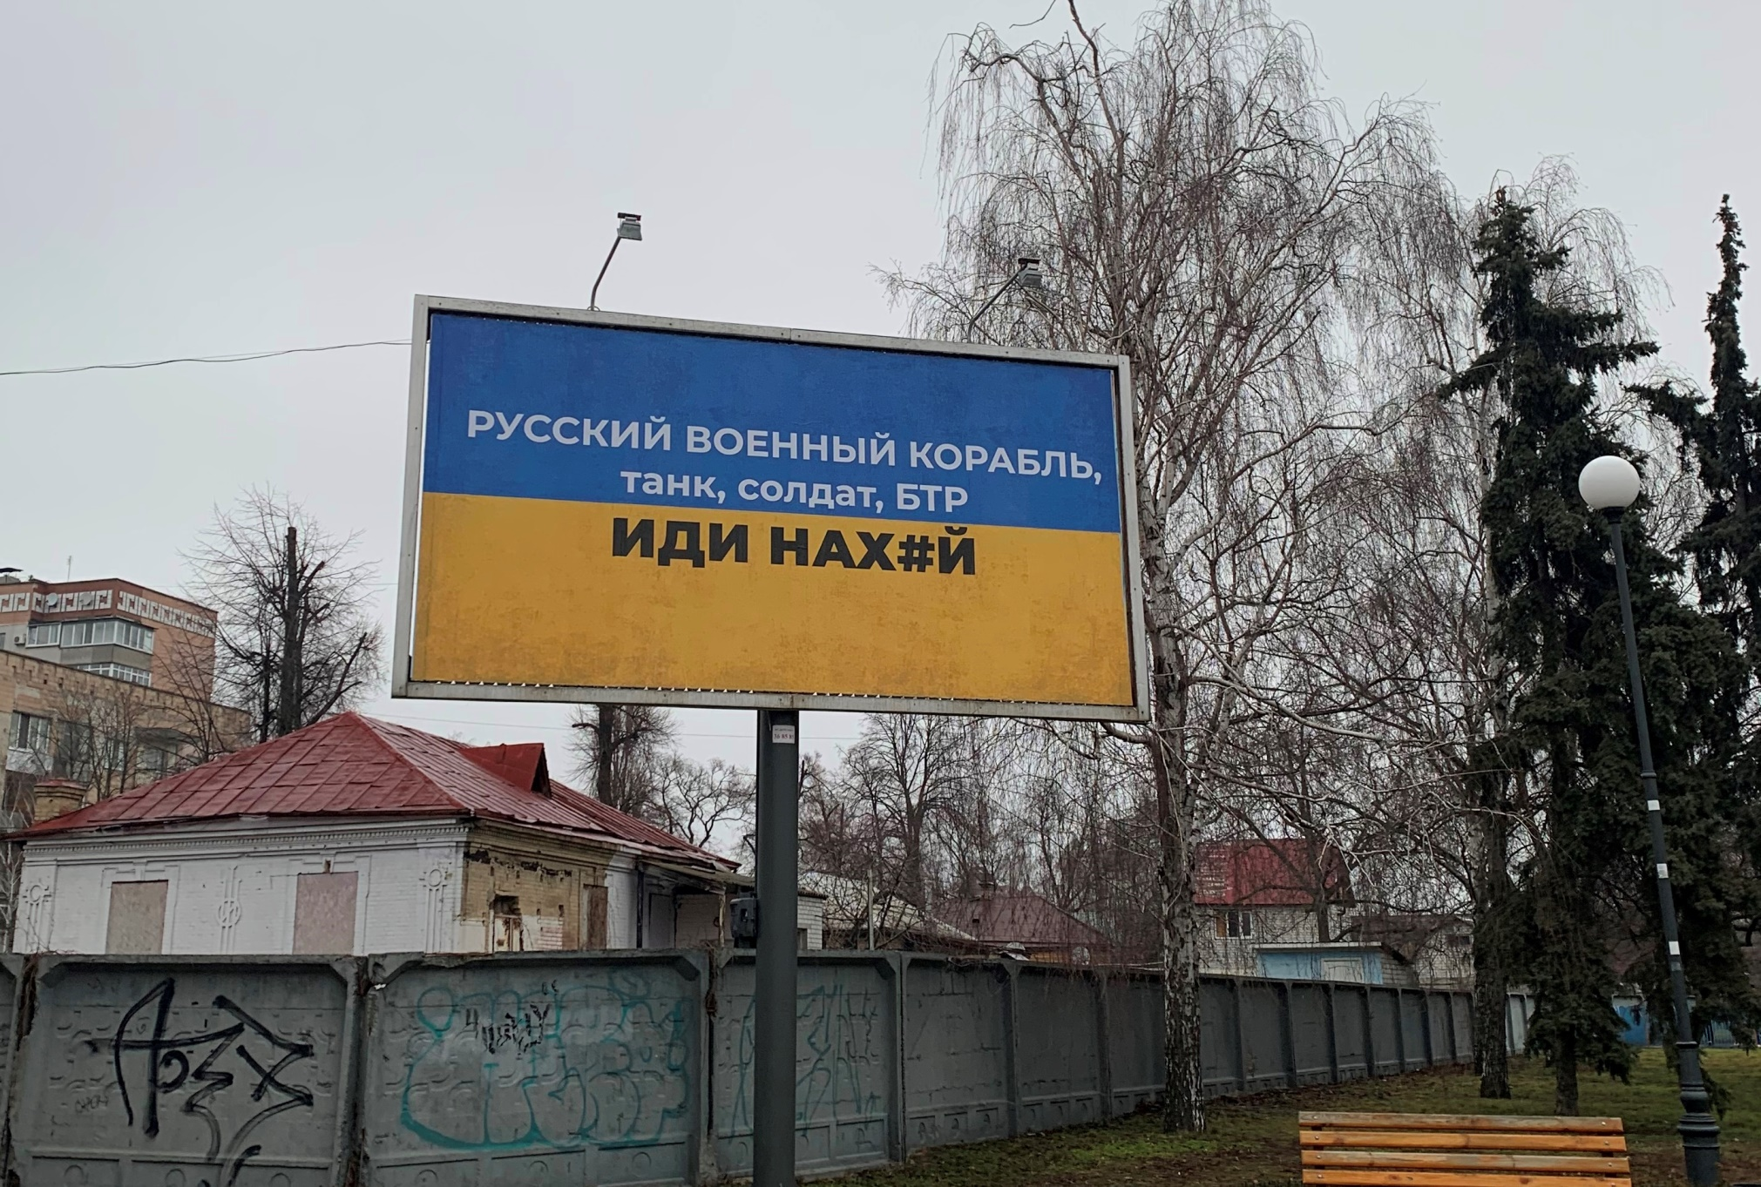
Banner example 1 (Cherkasy, spring 2022)
“Russian warship, tank, soldier, APC, go f*ck yourself!”

Slide 26
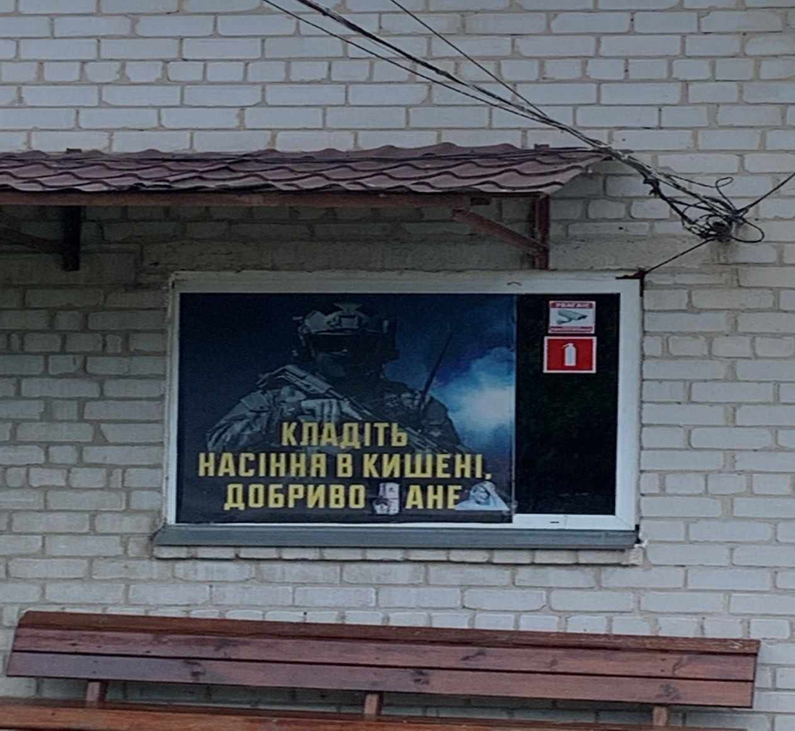
Banner example 2 (Cherkasy, spring 2022)
“Put some seeds in your pockets, you soil fertilizer!”

Slide 27
Table 6. How do you feel about the massive spread of slogans, billboards, political advertising with the use of profanity in the information space of Ukrainian cities?
№ | Answers | %
1 | I do not like it at all, because it downgrades the general level of culture among Ukrainians. Swearing is not our thing! | 53
2 | It is terrible. Children read this and start to think that swearing is the norm. | 13
3 | Normal, because now there is a war, and we need strong emotional appeals. We will think about the culture later. | 22
4 | It is normal, because people still use swear words in communication, so it does not change anything. | 5
5 | I even like it because it somehow invigorates and cheers me up. | 7
* Interestingly, at the time of writing (September-November 2023), this vocabulary has almost disappeared from the urban public space, replaced by quieter slogans of unifying and inspiring content, for example: “Cherkasy is Ukraine”. Exceptions include stickers on cars, postage stamps issued in the first months with the meme “Russian warship, go f...!”, as well as similar inscriptions on clothing and other household items.
* One respondent's comment to this question (stylistic peculiarities of the answer are preserved): “Мат – это тоже вплив РФ!” [Swearing is also the influence of the RF] (RF [Russian Federation] – O.P.).

Slide 28
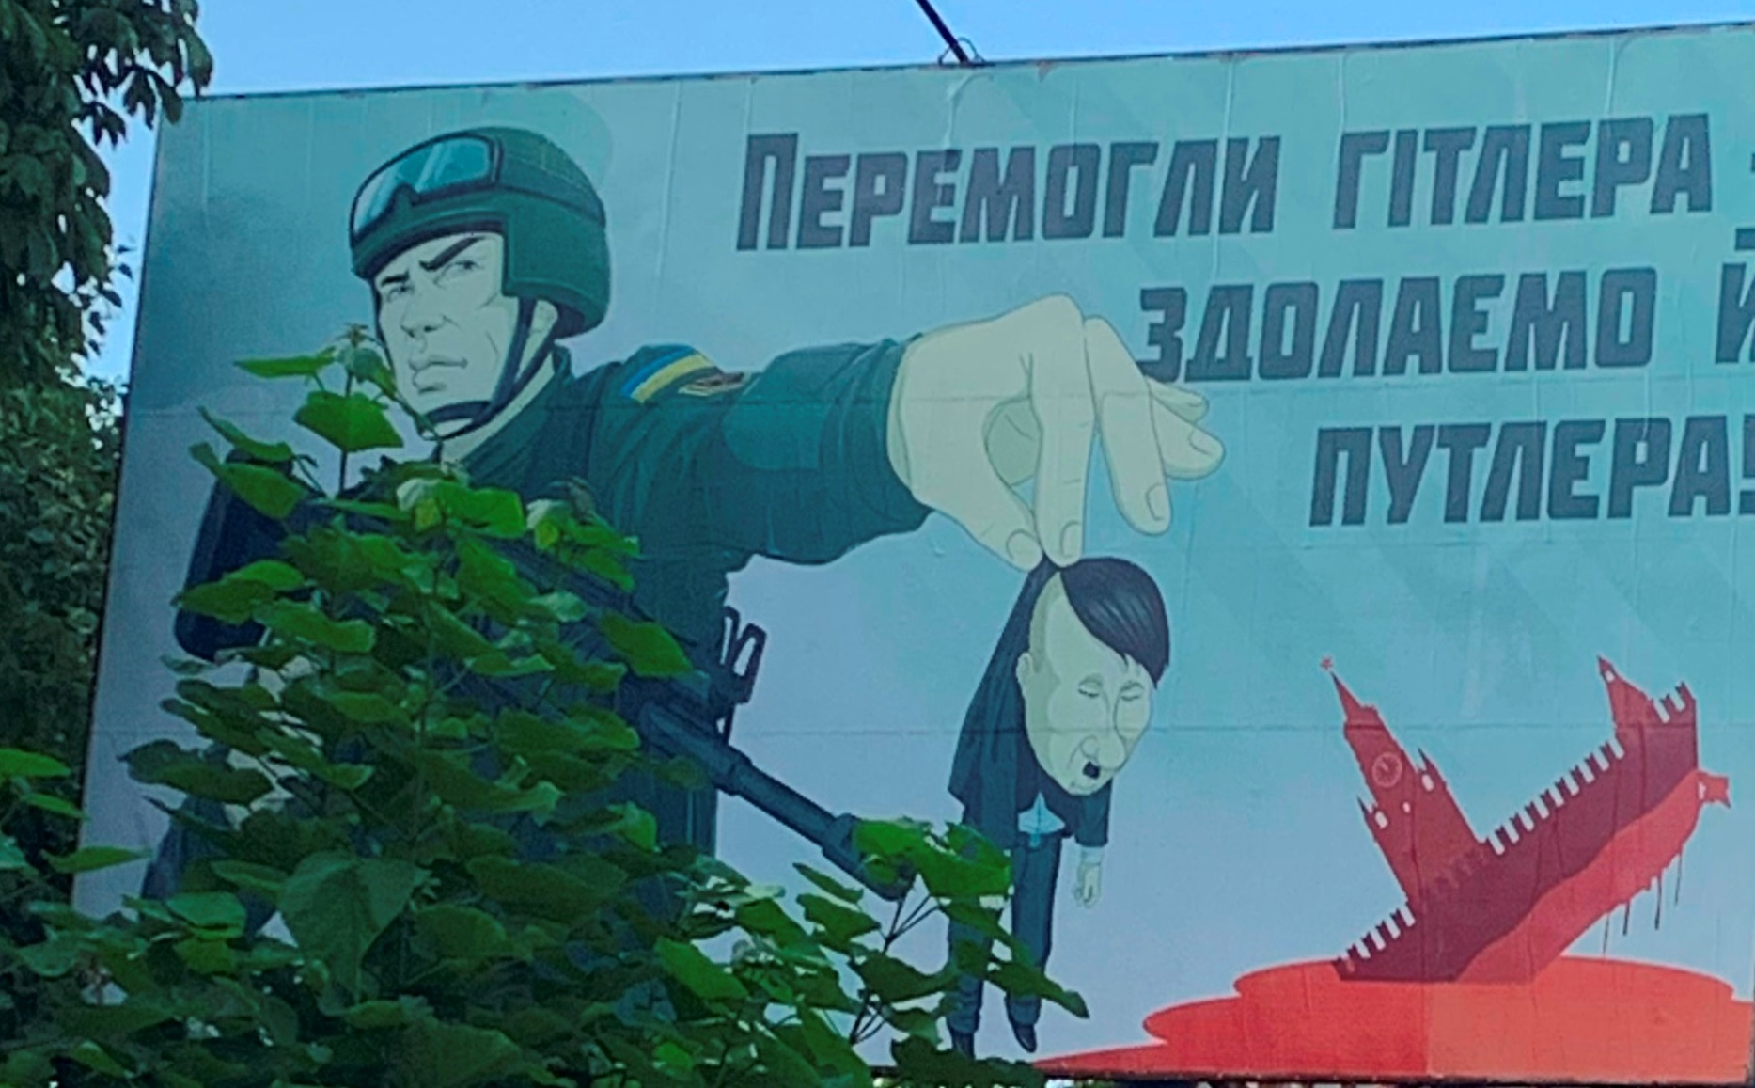
Cherkasy, 2023

Slide 29
The results of surveying representatives of education and culture living in the central regions of Ukraine (2022)
Changes in the attitudes of informants towards Russian culture
recognition of the works of Russian classics as a tool for enemy values propaganda or in the recognition of the inappropriateness of studying them in the original (two thirds of respondents in total),
a partial shift in the choice of modern fiction (some respondents refused to read Russian authors or Russian-language literature in general),
the rejection in principle of Russian musical content by the overwhelming majority (two of three) of respondents. At the same time, a third of the respondents were loyal to profanity in the official urban linguistic landscape.

Slide 30
The results of surveying representatives of education and culture living in the central regions of Ukraine (2022)
Changes in linguistic behaviour and attitudes towards Russian and Ukrainian:
Every third of those who used both languages for communication before February 24 (they made up almost half of the respondents), have now completely abandoned Russian and switched to Ukrainian, at that some of them feel irritation (10%) and even disgust (4%) to the Russian language.
Almost all Russian-speaking respondents have started to learn the Ukrainian language and try to speak it.
Five out of six respondents recognize the importance of the state language for national identity, nation, and state, of which two (30%) are forced to come to this position only now, after the outbreak of war.

Slide 31
One year later
What has changed?

Slide 32
Table 7. Has your language behaviour changed after February 24? |  |  | %
№ | Answers | 2022 % | 2023 %
1 | No, it has not changed: I spoke and speak mostly (exclusively) Ukrainian | 37 | 52
2 | No, it has not changed: I spoke and speak mostly (exclusively) Russian | 2 | 2
3 | No, it has not changed: I use both languages depending on the situation | 30 | 19
4 | It has changed: before I did not speak Ukrainian, but now I am learning it and trying to speak it | 15 | 1
5 | Has changed: I used both languages, now I speak only Ukrainian as a matter of principle | 12 | 19
6 | Has changed: I used both languages, now I speak only Ukrainian, because I feel aversion to Russian | 4 | 8

Slide 33
Table 8. Has your attitude to the Ukrainian language changed after February 24?
№ | Answers | 2022 % | 2023 %
1 | No, it has not changed: I have always considered the Ukrainian language an integral part of my national identity | 54 | 62
2 | No, it has not changed: I believe that it does not matter what language you speak, the main thing is that people have a good time living in their country | 15 | 7
3 | No, it has not changed: I think that there is too much attention to the language issue in general, and the beauty and cultural significance of the Ukrainian language is overestimated | 1 | 1
4 | It has changed: now I understand the true importance of the state language for the nation and the state | 20 | 14
5 | It has changed: I used to calmly accept (and use) both languages, now Russian just annoys me. My only language of everyday communication is the official language. This is fundamental | 10 | 16

Slide 34
Table 9. Has the war affected the choice of language of fiction you read (detective stories, translated fiction, etc.)?
№ | Answers | 2022 % | 2023 %
1 | I do not read fiction; I do not have time for it | 20 | 16
2 | Both before and now I read quality literature regardless of the country of origin and language | 34 | 23
3 | Both before and now I read mostly in Ukrainian | 27 | 34
4 | I read and continue to read fiction only in Russian | - | 1
5 | I like modern Russian authors, so I continue to read them, but now I pay more attention to Ukrainian authors | 2 | 2
6 | I have stopped reading Russian authors, but I read foreign literature in Russian translation | 8 | 7
7 | As a matter of principle, I have stopped reading Russian-language books | 9 | 17

Slide 35
Table 10. Do you think it is necessary for children in Ukrainian schools to read the works of Leo Tolstoy, Alexander Pushkin, Fyodor Dostoevsky?
№ | Answers | 2022 % | 2023 %
1 | Of course, it is necessary. This is a treasure of the world culture, and it cannot be cancelled | 23 | 15
2 | It is necessary, but in Ukrainian translation | 26 | 25
3 | No, it is not necessary. This is an instrument of propaganda of the values of the aggressor country hostile to us and it must be cancelled | 37 | 43
4 | I do not know | 14 | 17

Slide 36
Table 11. Has your attitude to Russian-language music content changed?
№ | Answers | 2022 % | 2023%
1 | No, it has not changed. I listen to the same music as before – different quality music, instrumental and songs, regardless of the language of performance | 13 | 18
2 | No, it has not changed: both before and now I prefer Ukrainian performers | 17 | 14
3 | I do not listen to music at all | 5 | 6
4 | It has changed: I am listening to Russian-language music content less than before | 47 | 24
5 | It has changed: Russian songs annoy me, I cannot listen to them at all | 18 | 38

Slide 37
Table 12. How do you feel about the massive spread of slogans, billboards, political advertising with the use of profanity in the information space of Ukrainian cities?
№ | Answers | 2022 | 2023
1 | I do not like it at all, because it downgrades the general level of culture among Ukrainians. Swearing is not our thing! | 53 | 38
2 | It is terrible. Children read this and start to think that swearing is the norm. | 13 | 46
3 | Normal, because now there is a war, and we need strong emotional appeals. We will think about the culture later. | 22 | 4
4 | It is normal, because people still use swear words in communication, so it does not change anything. | 5 | 10
5 | I even like it because it somehow invigorates and cheers me up. | 7 | 2

Slide 38
Our results reflect a general Ukrainian tendency to “become cold” toward the Russian language and Russian culture in general and to switch to Ukrainian as a language of resistance, a language of opposition to the enemy, and a language of self-identification.
Despite very positive trends in the formation of the national identity of Ukrainians, practitioners and theorists need to pay close attention to the rapidly changing linguistic and cultural situation in Ukraine during the war to prevent misalignments and conflicts based on language and culture issues.

Slide 39
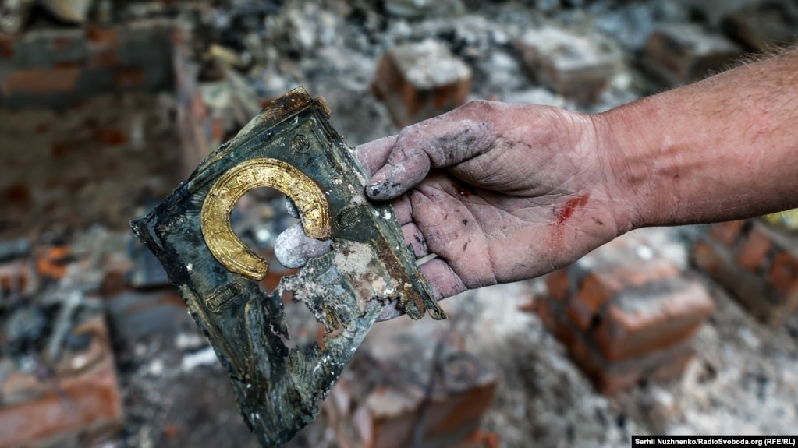
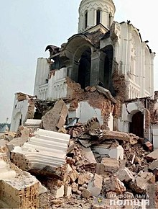
Chernigiv, 2022

Slide 40
References
Derzhavna sluzhba statistiki Ukrayini. [State Statistics Service of Ukraine] http://www.ukrstat.gov.ua/ (accessed 15 October 2022).
Konstituczi’ya Ukrayini [Constitution of Ukraine]. 1996. Vidomosti Verkhovnoyi Rady Ukrayiny 30. 141. https://zakon.rada.gov.ua/laws/show/254%D0%BA/96-%D0%B2%D1%80 (accessed 1 October 2022).
Osvita v Ukrayini: Bazovi indikatory. Informaczijno-statystychnyj byuleten’ rezul’tativ di’yal’nosti galuzi osvity u 2017/2018 n.r. [Education in Ukraine: Basic indicators. Information and statistical bulletin of the results of the education sector in 2017/2018 academic year] 2018. https://osvita.ua/doc/files/news/617/61743/1serpkonf-informatsiyniy-byuleten.pdf (accessed 5 October 2022).
Pro zabezpechennya funkczi’onuvannya ukrayins’koyi movy yak derzhavnoyi: Zakon [On ensuring the functioning of the Ukrainian language as the state language: Law]: 2704-VIII, redakcziya ot 02.01.2020: https://zakon.rada.gov.ua/laws/show/2704-19 (accessed 20 October 2022).
Seventeenth national survey: Identity. Patriotism. Values (17–18 August 2022). 2022. Sociological Group “Rating”, https://ratinggroup.ua/en/research/ukraine/s_mnadcyate_zagalnonac_onalne_opituvannya_dentichn_st_patr_otizm_c_nnost_17-18_serpnya_2022.html (accessed 5 November 2022).
The Sixth National Poll: the Language Issue in Ukraine (March 19th, 2022). 2022. Sociological Group “Rating”. https://ratinggroup.ua/en/research/ukraine/language_issue_in_ukraine_march_19th_2022.html (accessed 5 November 2022).
Vymoga kul’turnykh sankczij shhodo Rosijs’koyi Federaczii [Demand for cultural sanctions against the Russian Federation]. 28.02.2022. https://www.kmu.gov.ua/news/vimoga-kulturnih-sankcij-shchodo-rosijskoyi-federaciyi (accessed 10 October 2022).

Slide 41
Azhniuk, Bogdan. 2022. Ukrainska mova v suchasnykh umovakh derzhavotvorennia v Ukraini [The Ukrainian language in modern conditions of state formation in Ukraine]. Povidomlennia NAN Ukrainy 14.11.2022. https://www.nas.gov.ua/UA/Messages/Pages/View.aspx?MessageID=9617 (accessed 6 January 2023).
Kulyk, Volodymyr. 2022a. Die Sprache des Widerstands. Der Krieg und der Aufschwung des Ukrainischen. Osteuropa 6–8. 237–248. https://zeitschrift-osteuropa.de/hefte/2022/6-8/die-sprache-des-widerstands/english (accessed 6 January 2023)
Kulyk, Volodymyr. 2022b. Is Ukraine a Multiethnic Country? Slavic Review 81(2), 299–323. Published online by Cambridge University Press: 21 October 2022 doi:10.1017/slr.2022.152 https://www.cambridge.org/core/journals/slavic-review/article/abs/is-ukraine-a-multiethnic-country/F7A4132353341BF9B48D47BAB733981D (accessed 6 January 2023)
Kusse, Holger. 2019. Agressiya i argumentacziya [Aggression and Argumentation]. Vinnicza: Izdatel’stvo FOP Kushnir Yu.V.
Masenko, Larisa. 2018. Movnyj konflikt v Ukraini: shlyakhi rozvyazannya [Language conflict in Ukraine: the ways of settlement]. Ukrayins’ka mova 2. 20–35.
Mykhalchuk, Oksana. 2022. Sotsiolinhvistychni parametry bahatomovnosti: yevropeiski zasady i ukrainska diisnist [Sociolinguistic parameters of multilingualism: European principles and Ukrainian realityh]. Movoznavstvo 5. 42–57.
Pekar, Valerij and Vladislav Rashkovan. 2022. Ukrayins’ki osnovy [Ukrainian basics]. Kyiv: Folio.
Rudakevich, Oleg. 1995. Mental’nist’ i poli’tychna kul’tura ukrayins’koyi nacziyi [Mentality and political culture of the Ukrainian nation]. Rozbudova derzhavy 10. 26–30.
Shapoval, Yurij. 2008. Movna situaczi’ya v Ukrayini: mizh konfliktom i’ konsensusom, 12–33. Kyiv: IPiEND im. I.F.Kurasa NAN Ukrayini.
Sokolova, Svitlana. 2023. Zmina movnykh upodoban ukraintsiv na tli povnomasshtabnoi viiny: za rezultatamy opytuvannia vnutrishnikh pereselentsiv i mistsevykh zhyteliv [Change in the language preferences of ukrainians against a full-scale war: According to the results of a survey of internal displacements and local residents]. Ukraïns’ka mova 1.

