Slide 1
Digital transformation in Public Administration:
Emprical Evidence from Current Research Projects
Prof. Dr. Sabine Kuhlmann
University of Potsdam
Germany

Slide 2




DIGILOG research project
Digital transformation in European local governments,
especially its dynamics and effects
Cross-countries and over-time comparison (47 member states of the Council of Europe, 6 focus countries, 4 years development and beyond)
Quantitative and qualitative research methods (survey in all municipalities; case studies in selected countries/municipalities)
Monitoring platform via Crawling of websites of municipalities

Slide 3
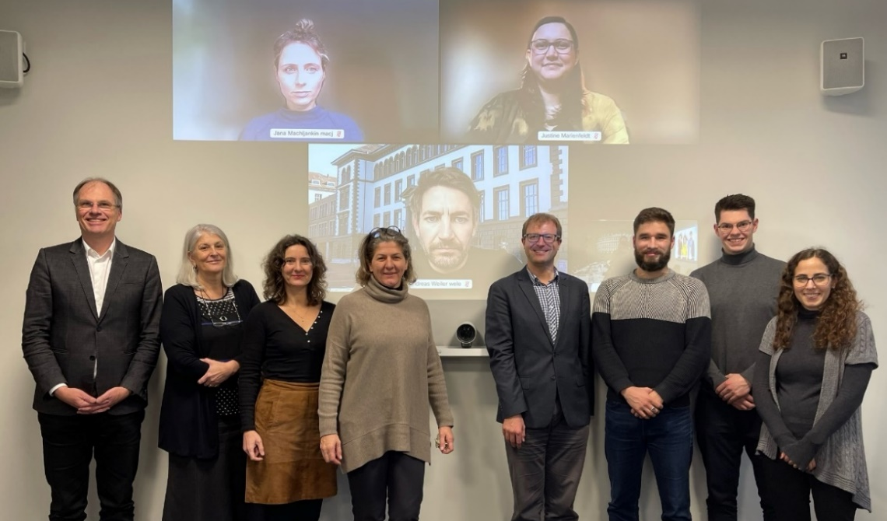




Research team
Binational research project funded by Swiss National Science Foundation (SNSF) and German Research Foundation (DFG), 2022-2025, 1.1 Mio. €
PI: Reto Steiner (ZHAW), Sabine Kuhlmann (UP), Isabella Proeller (UP), Renate Meyer (WU)

Slide 4
Research Goals
What are the dynamics (scale and pace) of digital transformation in European local governments?
  Radical revolutionary vs. gradual evolutionary.
  Finding differences from a cross-country and inter-municipal perspective.
What are the (intended and unintended) effects of digitalization on local self-government in different countries/regions?
  Outputs: service delivery, organization, processes, human resources.
  Outcomes: performance, accountability, work relief/burdens.
  Impacts: citizen acceptance, governance, new divisions.

Slide 5
Research Methods
Quantitative Survey
  Annual survey among leadership of local administrations in all CoE member states.
  Questions regarding digital maturity and causes and effects of digital transformation.
  First wave was concluded in January 2024; second finalized March 2025
Case Studies
  In-depth studies of countries and selected municipalities in Austria, France, Germany, Poland, Sweden, Switzerland, and the United Kingdom.
  Country-cases + local case studies
Web Crawling
  Crawling algorithm collects and analyses content of local government websites regarding digital maturity.
  Websites from 36,112 municipalities have been crawled.
  This means the project has analyzed the websites of around 39% of all municipalities in Europe.
Notes:
The map shows the share of municipalities analyzed by our web crawler in each country. The share was highest in Switzerland (98.92%) and Finland (96.12%) and lowest in Malta (16.18%) and Romania (16.42%). (Lichtenstein had 100%, but only has 11 Municipalities in our list)

Slide 6
Survey Response Rate
Survey response rates
High response rate
Low response rate
39,862 municipalities received our survey.
We received 2,950 responses,
(7.40% response rate)
High response rates in northern and eastern European countries.
Challenges in large countries and in those with many small municipalities.
France (1.55% response rate) and
UK (2.19%) are of particular concern.
Notes:
The map contains information on the response rates to our survey, with countries in green having higher response rates and countries in red lower response rates. The response rate was highest in Albania (66.67%) and Lithuania (52.73%) and lowest in Turkiye (1.13%) and France (1.55%)

Slide 7
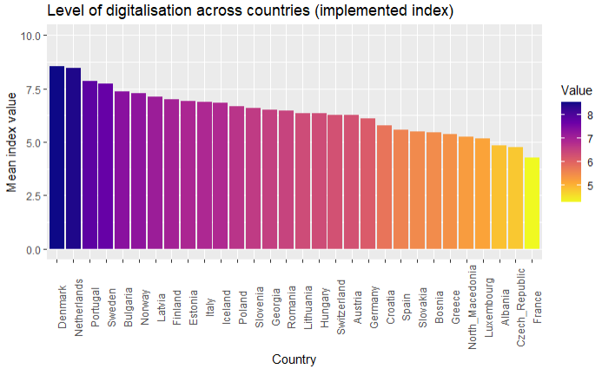
Digitalization Index
Notes:
The graph and map contain information on the digitalization index developed from the DIGILOG survey. The index allows for scores from 0 to 10, with 10 denoting high digitalization and 0 low digitalization. Countries with fewer than ten responses were excluded.

Slide 8
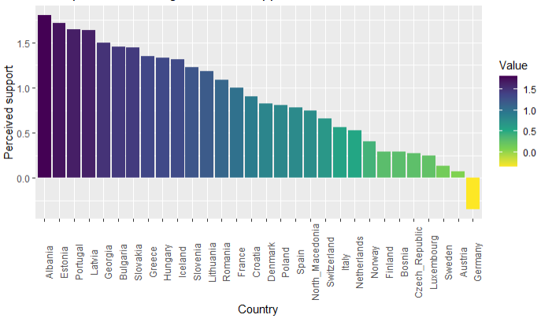
Perceived Central Government Support for Digitalization
Notes:
The graph and map are based on responses to the question «To what extent do you perceive the following actors as constraining or supportive for your digitalization efforts? Higher levels of government (regional authorities and / or central government). Responses ranged from Very constraining (-3) to Very supportive (3).

Slide 9
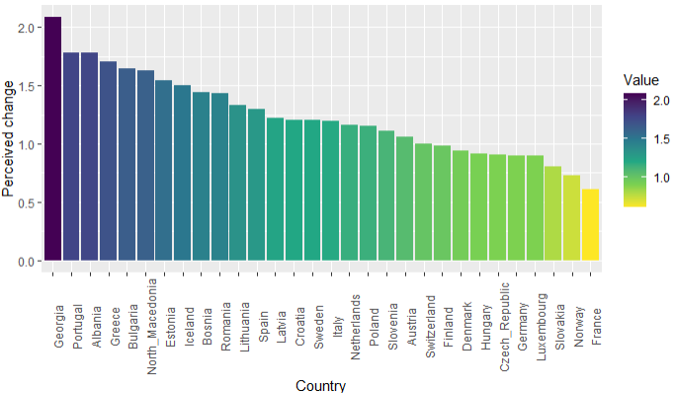
Perceived Improvement in Service Quality
Notes:
The graph and map are based on responses to the question “To what extent do you perceive that digitalization has changed your administration regarding the following aspects? Service quality” Responses ranged from Strongly decreased(-3) to Strongly increased(3).

Slide 10
Local Government Digitalization in 3 Focus-Countries: PA Profiles and Governance
The digital transformation of local governments:
France, Germany, UK compared
Exploring and explain the particularities of local level digitalization in 3 countries
Similarities/differences in digitalization governance, policymaking, outcomes ==Y causal links
RQ1: What governance arrangements do exist in the field of local governments’ digitalisation from a country-comparative perspective?
RQ2: How do these governance arrangements influence policymaking and outcomes in the field of local administrative digitalisation?
Aim: to develop and test a new analytical framework for comparing different countries’ digitalisation approaches at the local level of government

Slide 11
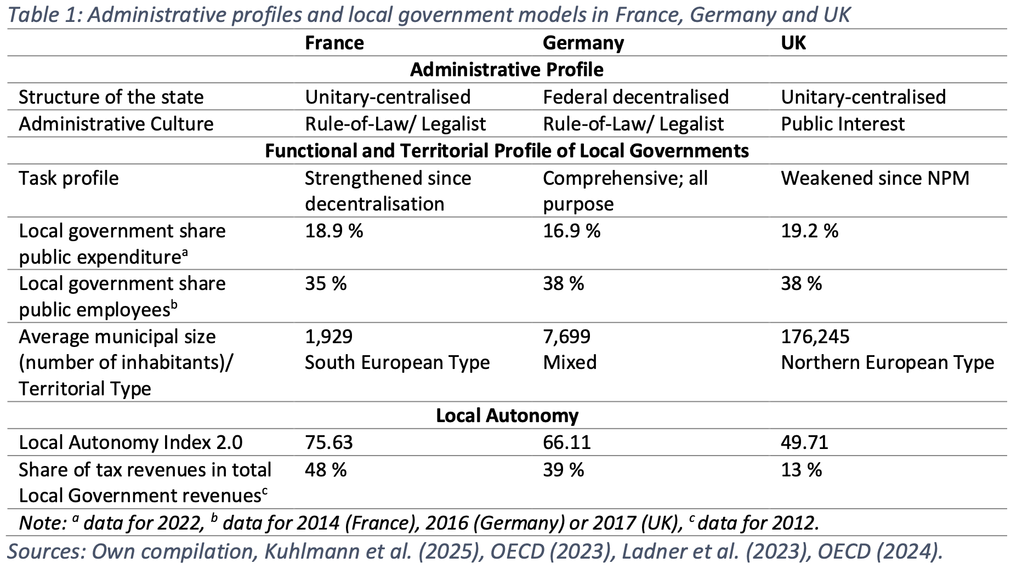
Administrative Profiles
Sabine Kuhlmann

Slide 12
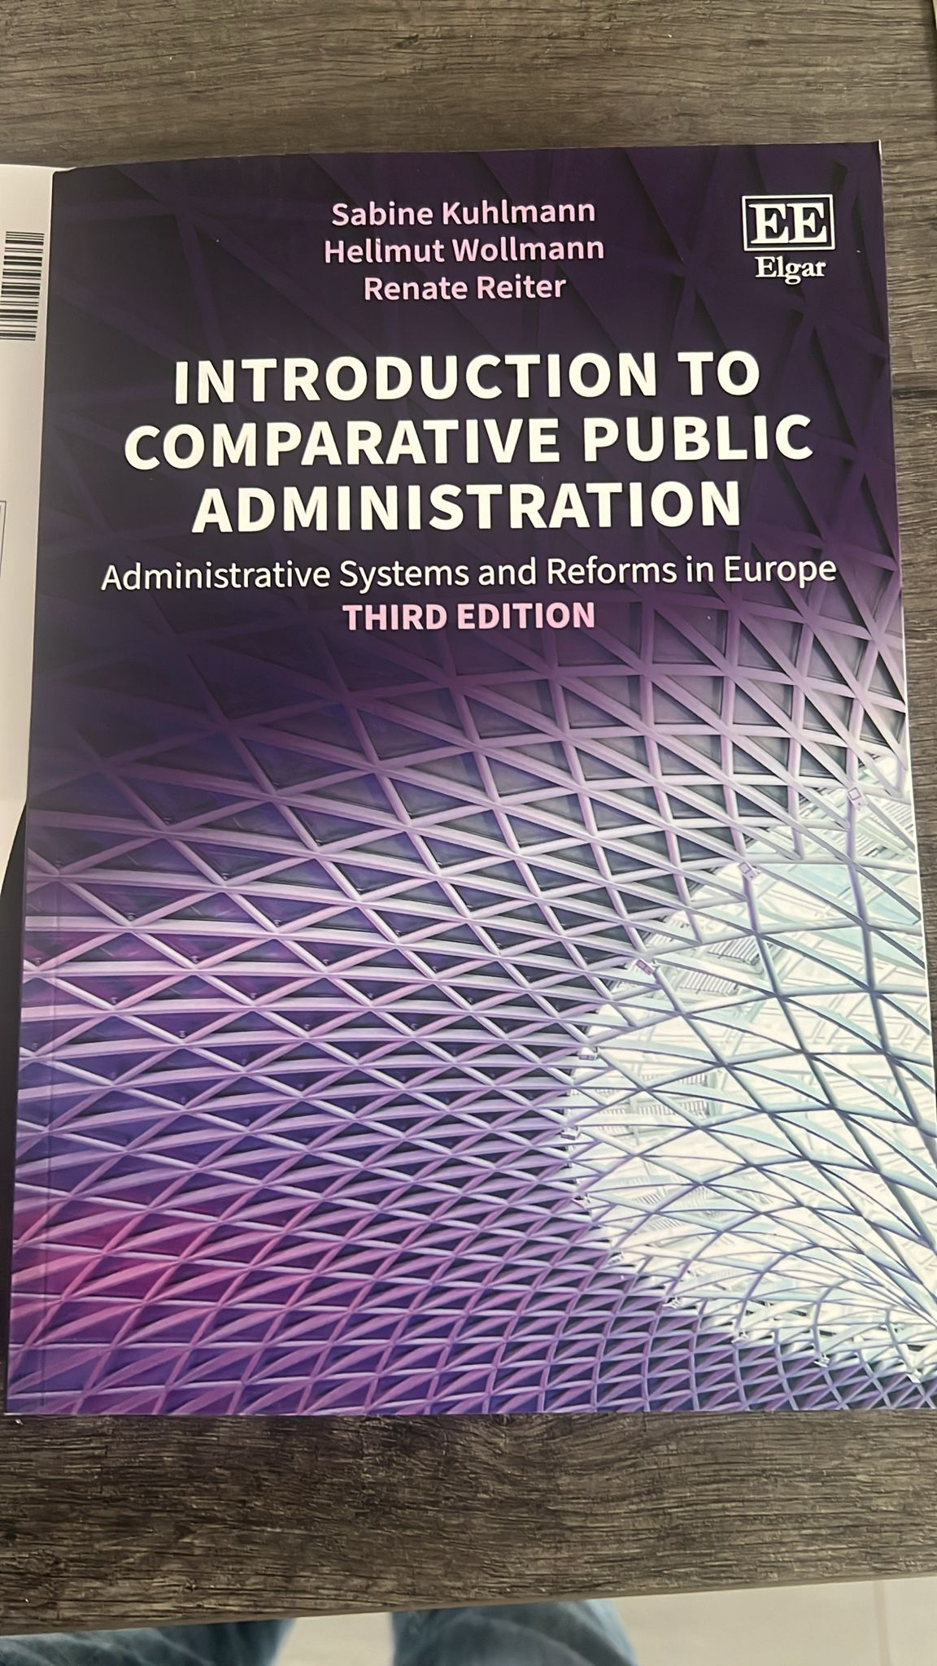
Kuhlmann, S./Wollmann, H./Reiter, R., 2025:
Introduction to CPA. 3rd Edition
Focusing on the UK, France, Germany, Sweden, Italy and Hungary, countries that represent key variations in European public administration, this textbook explores how the cultural, organizational, personnel and financial dimensions of public administration compare. The guiding questions are whether, to what extent and why the politico-administrative systems and their reforms show convergence or divergence from Europeanization.

Slide 13
Variables & Analytical Dimensions
Digitalisation Governance (ind. variable): Who is responsible for administrative digitalisation at different levels of government?
Policymaking (dep. variable): Dominant steering approach (enforcement vs. voluntariness); transitionary scope (radical vs. incremental); policy instruments:
  sticks: legislative and regulatory instruments;
  carrots: financial incentives and infrastructure support;
  programs: strategic plans, agreements, declarations;
  sermons: information, persuasion, guidelines (Vedung, 2003)
Outcomes (dep. variable): Digital maturity (internal/external); more far-reaching effects (digital divide, re-structuring of LG); un-intended consequences.
Sabine Kuhlmann
Notes:
GOVERNANCE: is the approach centralised or decentralised; is it coordinated or decoupled? What is the level of autonomy that local governments have?
POLICY: sticks, carrots, sermons; is the policy Legalistic, enforced, voluntary; Comprehensive or incremental?
EFFECTS: maturity level; internal changes; digital divide; structural reorganisation
Aim: … while contributing to the literature on Comparative PA

Slide 14
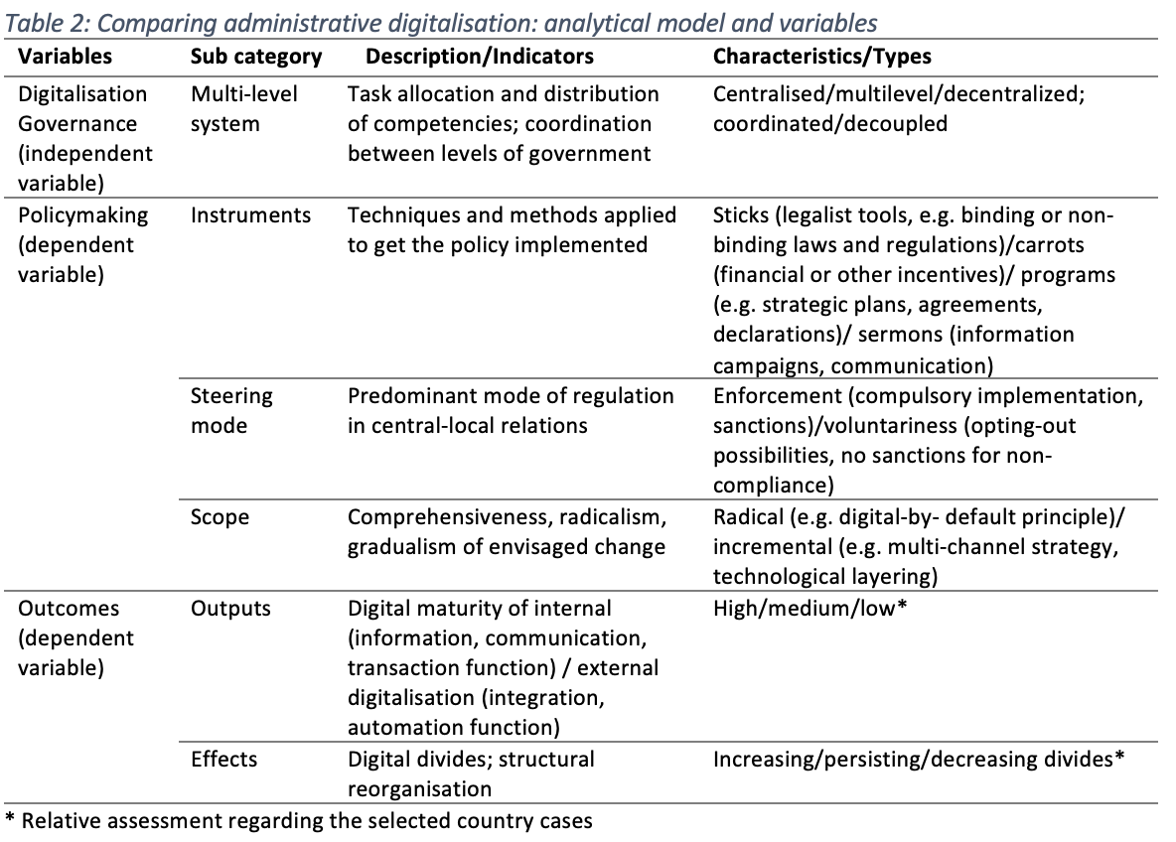
Analytical Framework
Sabine Kuhlmann

Slide 15
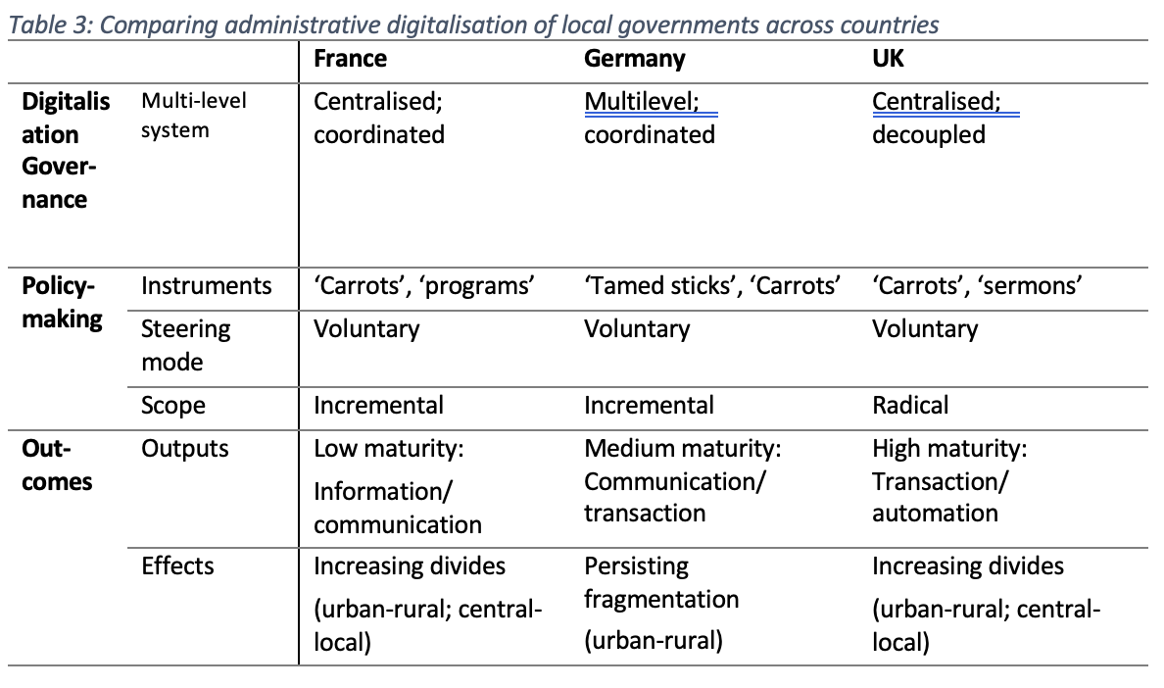



Comparison Results
Sabine Kuhlmann
Notes:
FRANCE
CENTRALIZED: most relevant organisations that drive governance are part of central govt
INTERGOV. and COORDINATED: collaborative approach to promote cooperation when implementing digitalization projects at the local level.; specific orgs. tasked with promoting that
There’s also a structured consultation process with stakeholders in the multilevel system, by which local authorities are involved in decision-making (local access)
CAPACITIES: HOWEVER smaller municipalities struggle with implementation due to limited resources
POLICY - LEGALISTIC BUT VOLUNTARY, comprehensive but non-binding plans and regulations. SO implementation on the local level is voluntary
Carrots and Sermons
EFFECTS: low digital maturity (local), focusing on basic information and communication services >> Many local adms still rely on paper-based processes for some functions
STRONG DIGITAL DIVIDE: disparities between urban and rural - infrastructure
GERMANY
HYBRID: responsibilities from federal, Länder and local levels. Mirrors German federalism (INTERGOV)
- There are organisations tasked with coordinating digitalisation across all levels (COORD)
- HOWEVER All Länder have their own digitalisation units – Länder and locals have substantial powers to determine own strategies
LOCALS HAVE medium access but high discretion – local gvmt not formally represented in decision-making bodies
- But can pursue their own approaches independently:
POLICY: Legalistic regulatory approach(but slow and late)
Voluntary implementation
YET AGAIN mostly carrots and sermons
EFFECTS: medium maturity at local level.
Communication and transaction at European average while internal processes are lagging behind
FRAGMENTATION
APPROACHES VARY ACROSS LÄNDER
different services offered by different municipalities + different portals for local, Länder and federal services
Strong digital divide
UK
HIGHLY CENTRALISED: GDS drives digitalisation
DECOUPLED: lack of coordination with local authorities for implementation and governance
Very few mechanisms that attempt to coordinate
GOV.UK is a centralized platform for public services provided by the central govt
but local authorities often have their own, less integrated systems.
NO ACCESS to central decision-making; no consultation
DISCRETION local gvts can decide independently and are not subject to mandatory central strategies
- But they lack powers and resources to pursue own comprehensive strategies
POLICY also VOLUNTARY
Strategies are declaratory, not mandatory
RADICAL (Digital-by-default)
- Carrots and Sermons
EFFECTS: advanced services offered by central govt
However many local services lagging behind due to low coordination
Strong digital divide

Slide 16
Conclusions
Digitalization governance (independent variable) follows traditional forms of governance in the countries studied (Kuhlmann et al., 2025) ➔ context matters for digitalization of local governments (Pollitt 2013)
  France: Centralised-coordinated approach of digitalization governance
  Germany: Multilevel-coordinated approach
  UK: Centralised-decoupled approach
Policymaking (dependent variable) shows more similarities ➔ soft instruments:
  voluntary approaches; incentives; “tamed sticks”
  LGs fairly independent in the design and implementation of their digitalisation strategies (high discretion)
Outcomes (dependent variable): varying levels of digital maturity; significant/growing digital divides (urban-rural; central-local) as key challenges
Sabine Kuhlmann
Notes:
In all cases… to varying degrees of success
Relation to preferences for voluntariness instead of enforcement

Slide 17

Two Research projects on the digital transformation in Germany (HBS)
Digitalisation in citizen services: vehicle registration, building supervision, tax administration
Digitalization in Local One Stop-Shops
Combination of qualitative and quantitative methods
100 expert interviews in total
Three in depth case studies: Freiburg, Mannheim, Karlsruhe
Mayors+staff survey on Local One-Stop-Shops (mayors: n=221, 30,7%; staff: n=263, 35,3%); + citizens‘ surveys (Bochum, Karlsruhe, Mannheim)
Administrative survey with 1,752 staff councils and employees in all German lower building authorities and vehicle registration authorities as well as employees of German tax offices (Nov. 2022 - July 2023)
  21% of all lower building authorities (197 out of 933 offices)
  29% of vehicle registration authorties (118 of approx. 394 offices)
  34% of tax offices (160 out of 473 offices)

Slide 18





Interests of Research
Staff-related Changes
Organisational Changes
Changes in Internal Participation
Changes in Performance and Service Delivery
Digitalisation Status & Hurdles
Prof. Dr. Sabine Kuhlmann

Slide 19
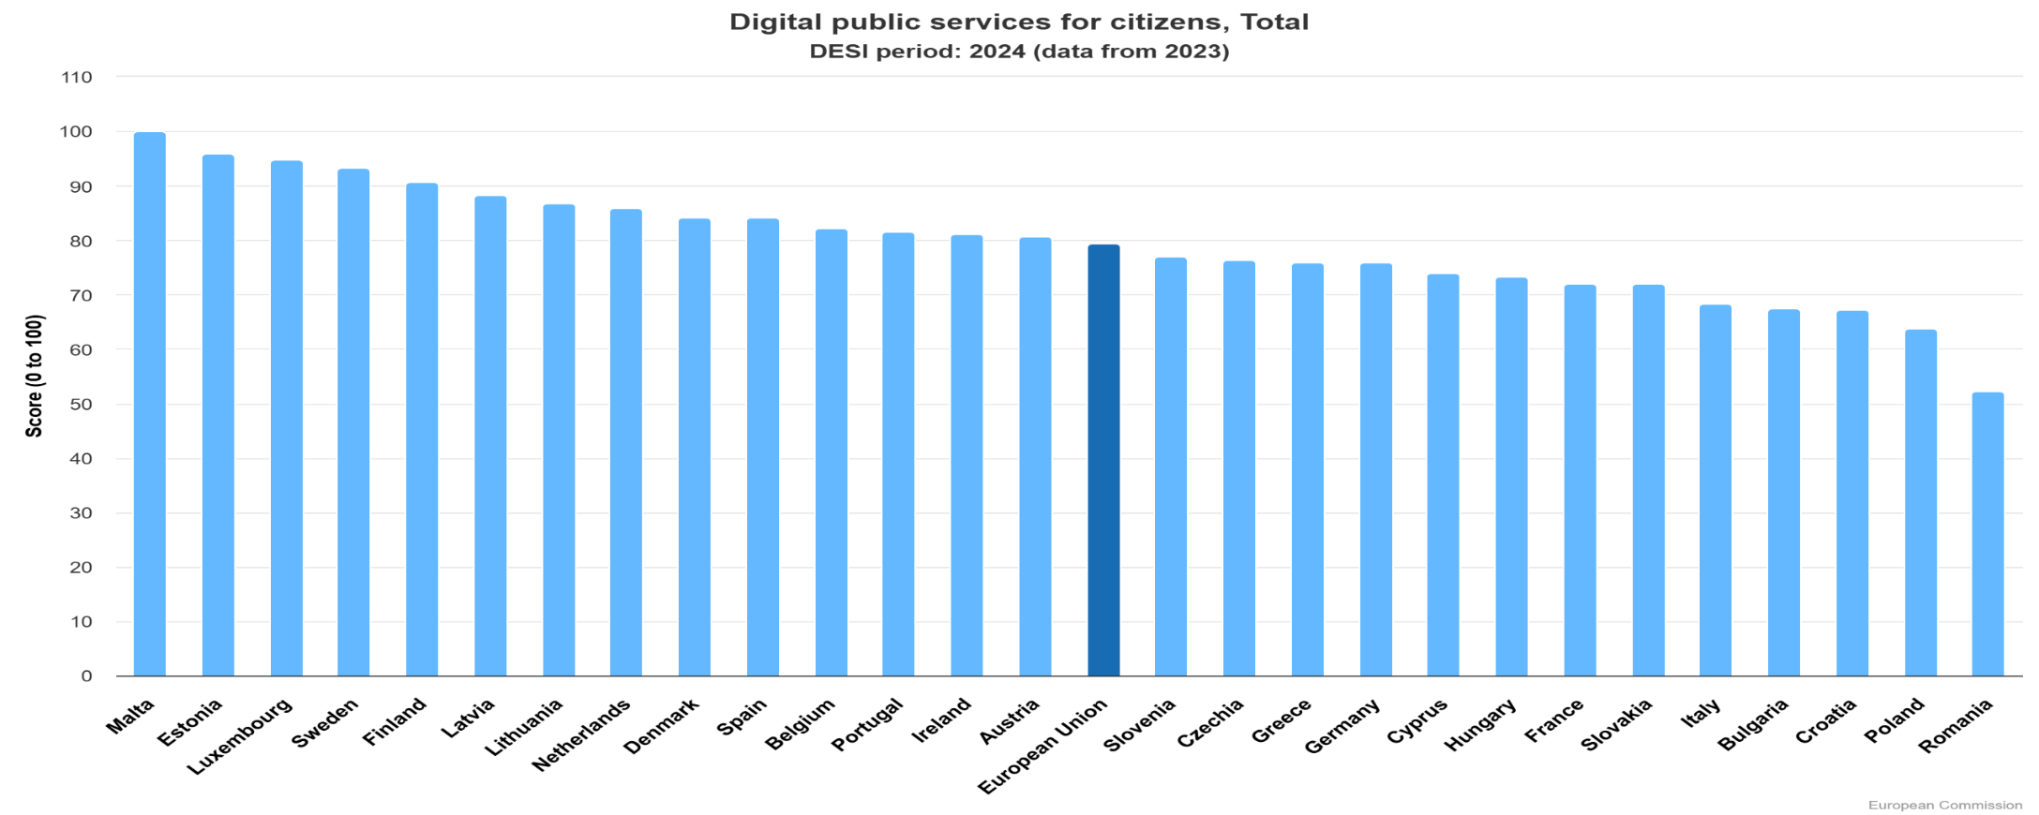
Germany's position in international rankings on the digitalization of public administration

Slide 20
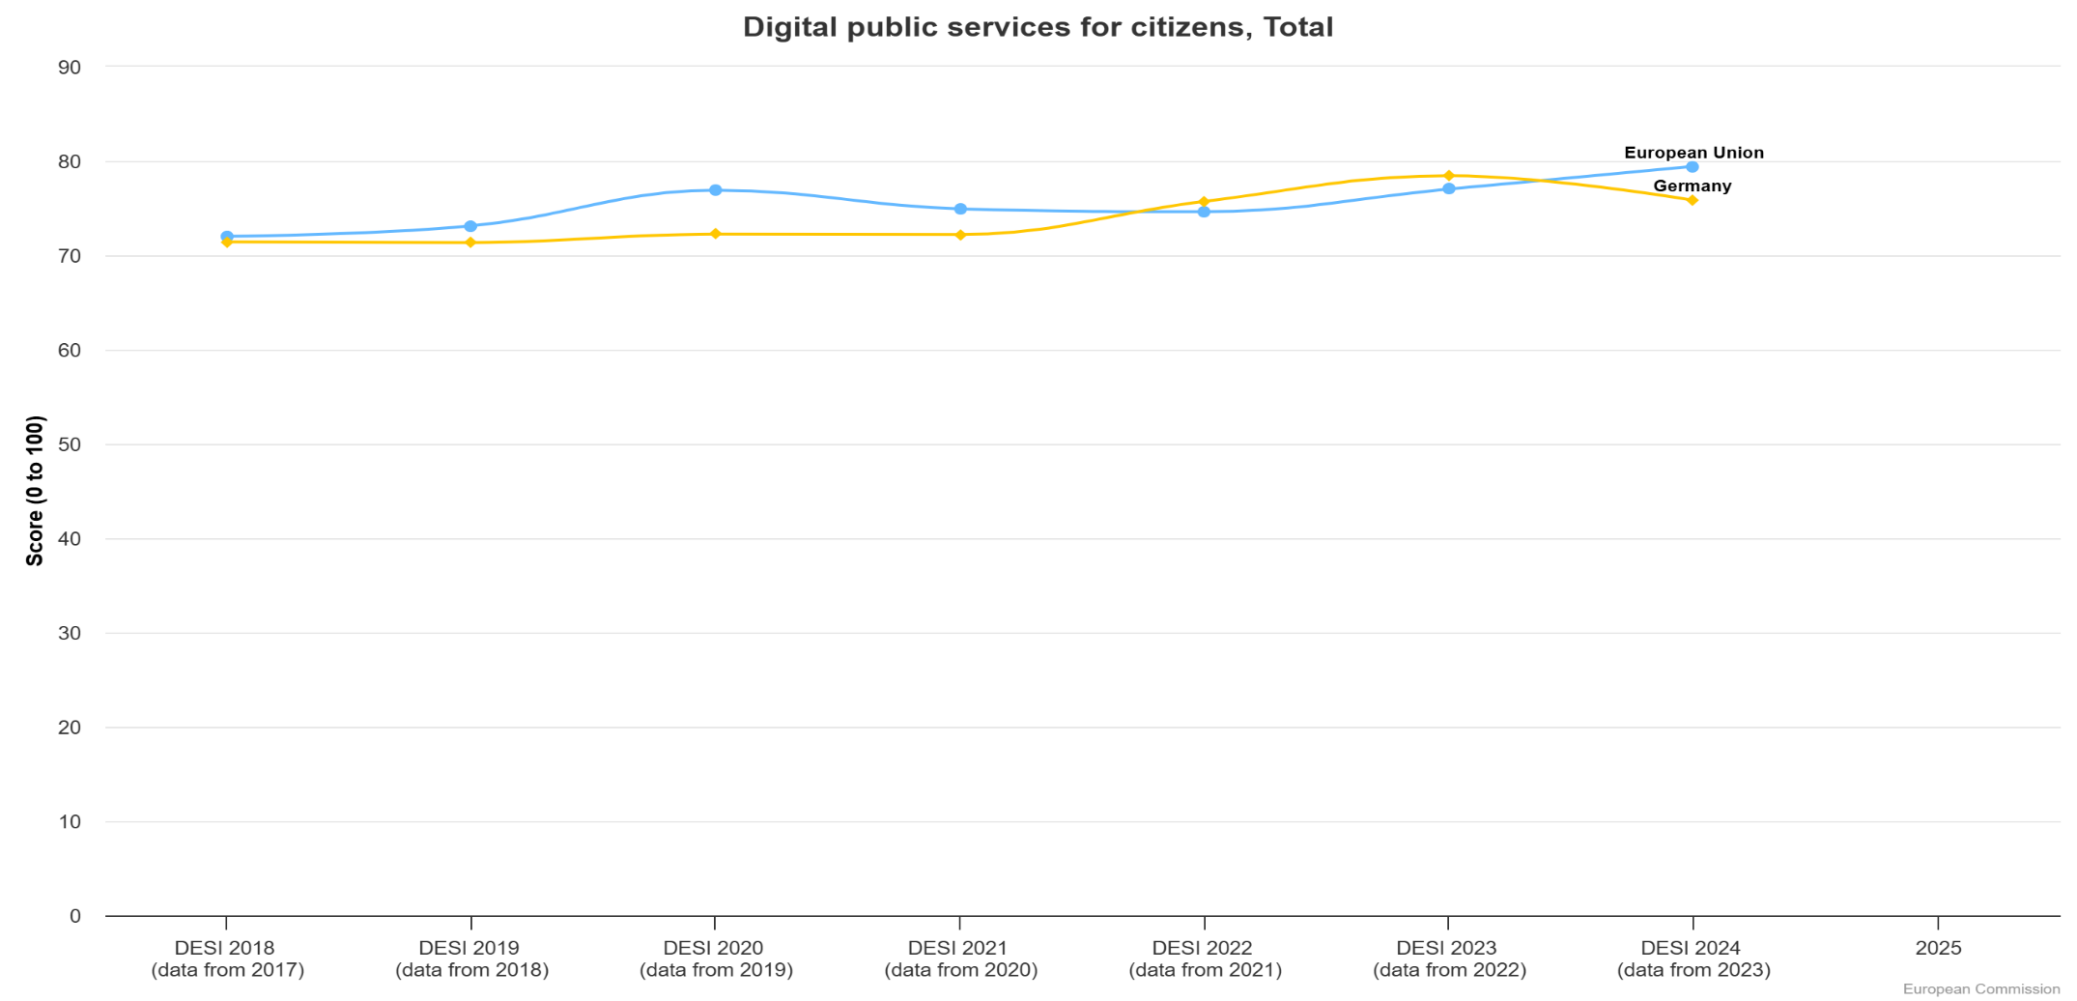
E-government over time: Germany in an EU comparison
Savings potential through digitalization:
3 billion euros per year for TOP 60 administrative services (NKR);
Prerequisite: high level of maturity; “good” digitalization

Slide 21
Numerous reasons for digitalization backlog
Legalistic administrative culture ➔ high number of written form and documentation requirements + authentification and attendance requirements (federal norm screening unsuccessful)
Historically rooted fear of the "transparent citizen" ➔ restrictive data protection regulations; strict privacy rules; data protection rules outdated)
Technical/structural problems: lack of basic digital components, e.g. for "once only" principle (modernization of registries needed)
Capacity problems (personnel, IT-talents; process know-how, finances)
Missing overall digital architecture in the federal system (decentralized systems do not fit to central/standardized digital components)
Governance problems in the federal multilevel system

Slide 22
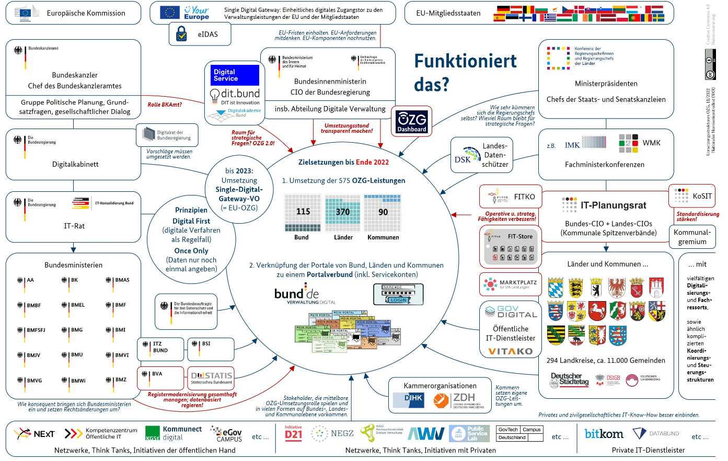
How Digitalization Policy is organized in the German Federal System
Source: Pixabay

Slide 23
Controversial Debate about Decentralization vs. Standardization/Centralization in Adm. Digitalization
Standardization/Centralization
Standardization to be pushed by scentral level ➔ necessary for uniform service and usability standards (equal treatment of citizens)
Uniform procedures important for delegated state tasks
Many LGs welcome pressure for more standardization
States hesitant because of financial implications
Pro state-/ federal solutions
Local Variety/Decentralization
Some LG’s consider upper levels too remote to grasp how things work in practice on the local level
Bottom up-strategy for digital solutions preferred from a street-level perspective
Knowledge on the ground indispensable for user-friendly solutions
Pro Local solutions
Notes:
23

Slide 24
6 Key Messages from Research
Prof. Dr. Sabine Kuhlmann

Slide 25
Key Messages I
1. Huge variance in German authorities’ digitalisation
Tax administration: most advanced: with 31.6 million electronically transmitted tax returns per year (2021)
Vehicle registration: internet-based procedure implemented in 83% of all authorities; but: only marginally used by citizens
Building supervisory boards: online building application implemented in 42% of the authorities (varying digital maturity)
2. Neglect of internal digitalisation
Internal digitalisation seriously neglected: e-file systems, automated data exchange;
Many media discontinuities (paper-digital; incompatible software)
No systematic integration of specialised software in overall digital architecture

Slide 26
Internal Digitalisation: E-File Systems
 |  | Vehicle registration | Building authority | Tax office
E-file introduced |  | 70,2 % | 59,8 % | 97,3 %
 | Exclusively electronic file management | 76,3 % | 19,8 % | 0 %
 | Simultaneous paper and e-file management | 23,7 % | 80,2 % | 100 %
 | Systematic digitisation of old files | 84,5 % | 37,5 % | 5,1 %
Prof. Dr. Sabine Kuhlmann

Slide 27
Titel
Source: city survey (mayors). Question: “Which services of your local one-stop shop are online available and to what extent?
Internal Digi (End-to-End) in Local One-Stop-Shops)
Service | Information available online | Partially processed online | Fully pro-cessed online (end-to-end) | N
Passports | 87% | 21% | 2% | 210
Certificates (birth / marriage) | 67% | 44% | 10% | 101
Criminal record | 75% | 26% | 23% | 205
Registration of residency | 80% | 39% | 3% | 205
Authentication of certificates | 96% | 8% | 1% | 178
Dog tax registration | 80% | 33% | 6% | 118
Residents parking perming | 81% | 27% | 8% | 84
Parking permit for people with disabilities | 91% | 18% | 0% | 87
Housing benefits | 85% | 30% | 0% | 54
Vehicle registration | 83% | 33% | 10% | 48

Slide 28
Key Messages II
3. Efficiency gains do not impact on employees’ work
On the one hand: increased efficiency through improved case processing, elimination of postal routes; automated data exchange
On the other hand: duplication of work due to parallel analogue and digital processes and the new process steps (scanning, software administration, IT support)
4. Technical problems as key barrier
Frequent IT and software failures ➔ negative impact on employee satisfaction
Poor technical implementation of digital processes negatively impact on quality, speed and efficiency of digital administration

Slide 29
Technical Problems as Key Barrier
"I am very open to digitalisation, but I find the fact that there is currently a considerable additional workload annoying and counterproductive."
(Free text feedback tax, Berlin)
“Any digital innovation is received in an unfinished and immature manner and causes more problems than it helps.”
(Free text feedback tax, NRW)
„At times, thousands of tax officials in Baden-Württemberg sit around for hours, unable to work. People are frustrated that they can't work. We're not lazy—it's being made impossible for us to work.“
(Free text feedback tax, BaWü)
“The fact that the program is cancelled at least twice a week is very frustrating and now simply ridiculous.”
(Free text feedback tax, BaWü)
Prof. Dr. Sabine Kuhlmann

Slide 30
Key Messages III
5. Digitalisation tasks performed ‘on the side’
Additional staff for both the new sub-processes (IT administration, scanning, support) and for change management are necessary but often not available
6. Better data quality, yet no impact on legal quality
Improved data quality/reliability
However: no measurable impact on legal quality of administrative acts (lawsuits numbers stable)
Advantages if these digitalisation tasks are carried out by specialised persons or organisational units
Reduced post-processing communication for case workers

Slide 31
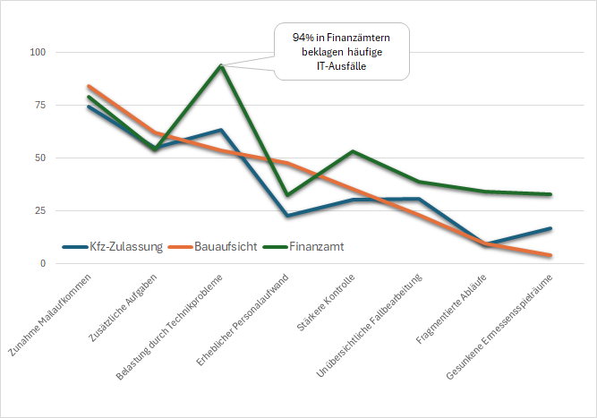
Effects of Digitalization?
The Staff’s Perspective
  Poor satisfaction with digitalization:
  building supervision: “sufficient” (4,0);
  vehicle registration: “satisfactory” (3,3);
  tax admin: “inadequate” (4,6)
94% of tax offices complain about frequent IT failures
Prof. Dr. Sabine Kuhlmann
Problemstellungen durch Digitalisierung der Verwaltungsprozesse im Vergleich (in % der Beschäftigten)

Slide 32

Outlook: Digitalisation Ggovernance
Recommendations:
Digital ministry with central responsibility for digitisation of public administration
Support via an operative digital agency with an implementation focus
Define objectives and indicators and monitor them using a dashboard
Source: Pixabay

Slide 33

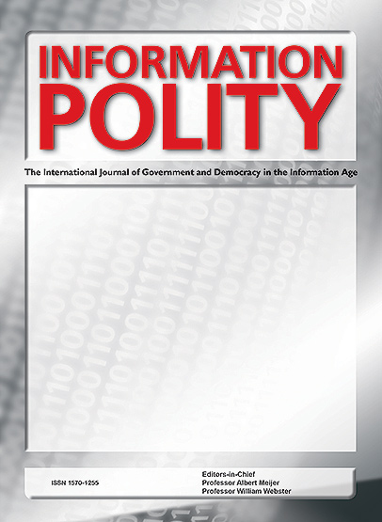

Project publications (a selection)
Gräfe/Marienfeldt/Wehmeier/ Kuhlmann, 2024: Changing tasks and changing public servants? The digitalisation and automation of public administrative work
https://doi.org/10.1177/13837605241289773
Marienfeldt/Wehmeier/ Kuhlmann, 2024: Top down or bottom up digital transformation? A comparison of institutional changes and outcomes. https://doi.org/10.1080/09540962.2024.2365351
https://doi.org/10.5771/9783748944348
Prof. Dr. Sabine Kuhlmann

Slide 34



S. Kuhlmann, M. Laffin, E. Wayenberg, T. Bergström (2024): New Perspectives on Inter-governmental Relations
Crisis and Reform
https://doi.org/10.1007/978-3-031-61790-4
Sabine Kuhlmann (2024)
Back to Bureaucracy?
The Advent of the Neo-Weberian State in Germany
https://doi.org/10.52372/jps39202
S. Kuhlmann, J. Franzke, N. Peters, B. P. Dumas (2024)
Institutional designs and dynamics of crisis gover-nance at the local level
https://doi.org/10.1080/25741292.2024.2344784

Slide 35
Titel
Appendix - Data Basis: Digitalization in Local One-Stop-Shops
4. Mayors, staff, and citizens‘ surveys on Local One-Stop-Shops
 | Target group | Overall population | Response rate
Administration survey (every city >15.000 inh.) | Mayors Staff councils | N = 721 N = 746 | n = 221, 30,7% n = 263, 35,3%
Staff survey (Bochum, Karlsruhe) | One-Stop-Shop staff, Bochum One-Stop-Shop staff, Karlsruhe | N = 75 N = 135 | n = 40, 53,3% n = 70, 51,9%
Citizens survey (Bochum, Karlsruhe, Mannheim) | Citizens Karlsruhe Citizens Bochum Citizens Mannheim | Random sample 6000 Random sample 2000 | n= 1171, 19,5% n = 418, 21% n= 201

