Slide 1
Digital Transformation at the Local Tier of Government in Europe: Dynamics and Effects from a Cross-Countries and Over-Time Comparative Perspective (DIGILOG) The digital transformation of public administration in a federal context: Austria, Germany, Switzerland compared
Prof. Dr. Sabine Kuhlmann

Slide 2
DIGILOG research project
Digital transformation in European local governments, especially its dynamics and effects
Cross-countries and over-time comparison (47 member states of the Council of Europe, 6 focus countries, 4 years development and beyond)
Quantitative and qualitative research methods (survey in all municipalities; case studies in selected countries/municipalities)
Monitoring platform via Crawling of websites of municipalities

Slide 3
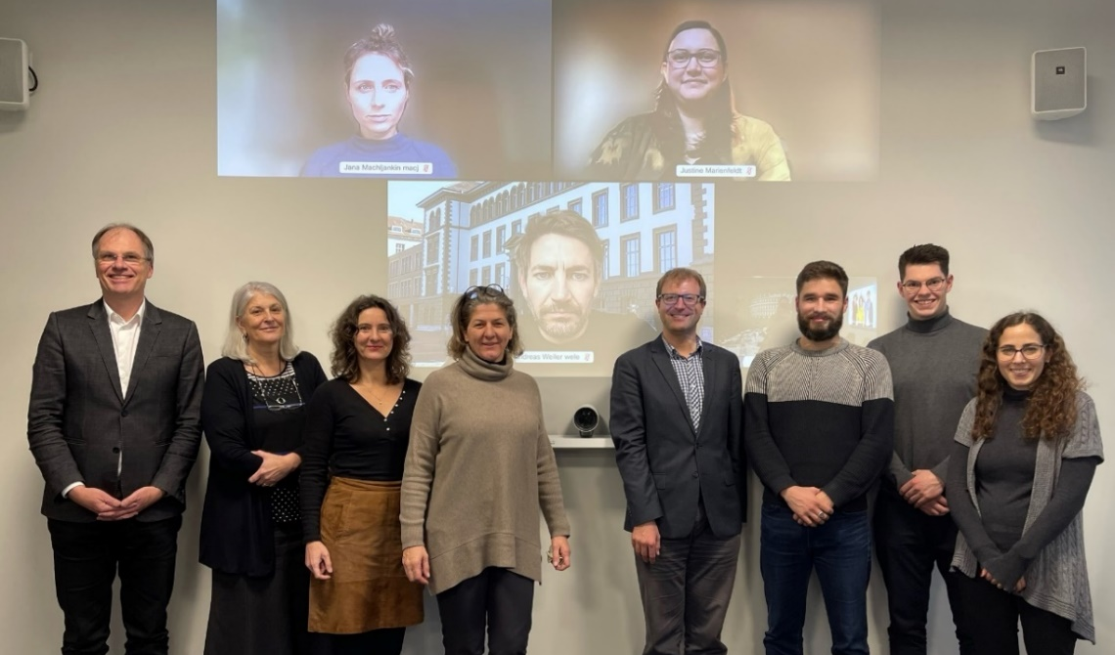
Research team
Binational research project funded by Swiss National Science Foundation (SNSF) and German Research Foundation (DFG), 2022-2025, 1.1 Mio. €
PI: Reto Steiner (ZHAW), Sabine Kuhlmann (UP), Isabella Proeller (UP), Renate Meyer (WU)

Slide 4
Research objectives/question of the TED paper
The digital transformation of public administration in a federal context: Austria, Germany, Switzerland compared
Exploring the particularities of local level digitalization in a federal context (specific complexity, steering problems, decision-making deadlocks, fragmentation)
Yet differences in digitalization outcomes in DACH countries (Germany, Austria, Switzerland) despite similar administrative profiles = research puzzle
RQ: How is administrative digitalization organized in the multi-level system of the DACH countries and what role does the Continental European Federal model of public administration with sub-national/local governments as key actors play?

Slide 5
Concepts/definitions: External and internal digitalization
External digitalization
Change in the provision of services to citizens or companies
Communication and interaction between citizens and the administration via Internet technologies
Internal digitalization
Adaptation of processes within the administration and between administrative units, organizations and levels
Administrative digitalization encompasses product and service innovations as well as organizational and process innovations based on the introduction of new digital technologies
Varying scopes of the change: digitization = 1:1 conversion from analogue to digital; digitalization = adaptation of services and processes; digital transformation = cultural, organizational and relational changes (Mergel et al. 2019).

Slide 6
Concepts/definitions: Administrative profiles: the DACH region
Similarities ➔ common “starting conditions”:
DACH countries share a common Continental European Federal administrative profile
Legalistic administrative culture prevalent (potentially inhibits digital tool adoption)
Differences in PA/federalism/LG-system:
Legalism more pronounced in Germany and Austria
Variations in federalism: cooperative (Germany, Austria) vs. competitive (Switzerland)
Local Autonomy Index: CH 79; G 73; A 63
Fiscal discretion of LG’s (share of tax revenue that the municipalities themselves decide on in the overall municipal budget): CH 60%; G 23%; A: 35%
CH peculiarity: direct democratic procedures; competition at the subnational level (e.g. tax competition between municipalities)
Civil service systems: civil servants as “servants of the state”” (G/A) vs. “employees of the people” (CH)

Slide 7
Germany
Complex governance structure with federal, Länder, and local authorities involved in digitalization
Fragmented implementation process involving multiple actors, contributing to lagging behind in international rankings
Constitutional amendments and the Online Access Act (OZG), from 2017, aimed at digitalizing administrative services by 2022
OZG is considered a failure by experts due to lack of legal entitlement for citizens and of administrative consequences
OZG 2.0, adopted in February 2024, conceives digitalization as a permanent task ➔ however scepticism about future digitalization progress remains

Slide 8
How Digitalization Policy is organized in the German Federal System

Slide 9
Germany: Collaboration in the Federal System: The Online Access Act as a Multi-Level Challange
Digitalization as a multidimensional "collective work" that cannot be processed by one level only (multi-level problem); consequently:
Process of digital transformation withing administratively interwoven structures
One level cannot make decisions without the involvement of the other level(s)
Thus, there is an institutionalized necessity to cooperate:
Horizontally ➔ cross-departmental coordination necessary (e.g. 5 ministries responsible at federal level; but mostly "negative coordination”)
Vertically across all levels of government (e.g. “IT planning council” as an intergovernmental body of the federal and Länder governments)
Variations in digital maturity at the local level according to strategic preferences, capacities
Complete online processing of public services without media-discontinuities remains an exception (focus mainly on information/communication, not interaction)

Slide 10
Austria
Governance of the digitalization in the multilevel system is more centralized (responsibility concentrated in the Federal Ministry of Finance)
More top-down steering, stringent standardization, focus on key infrastructure components (e.g. modernization of public registries); unlike German OZG with its 575 services as focus
Austria is ahead of Germany in most fields of the administrative digital transformation (also ahead of Switzerland in many respects)
With the "Digital Office", Austria is among the European leaders in the user-friendliness of digital services via cell phones (DESI 2023).
E-Government Act of 2004 was one of the first digitalization laws in the EU (unlike German OZG, it regulates the fundamentals of digitalization)
Concrete implementation projects not agreed by law, but via administrative agreements
Problems/limits: no overarching digitalization strategy; fragmented municipal landscape

Slide 11
Switzerland
Cantons insist on an equal-footing cooperation with the federal level ➔ strong and autonomous position of cantons
Equal-footing collaboration with strong cantonal autonomy institutionalized in 2022 ("Digital Administration Switzerland" organization, supported by all 3 levels)
Mainly voluntary self-regulation of cantons; cantonal resistance against centralized legislation
No federal law to regulate administrative digitalization ➔ rejected by cantons
Instead, time-limited voluntary framework agreements since 2012 (Swiss eGovernment Strategy 2020-2023) jointly adopted by the three levels
Huge differences in digitalization strategy and organization between the cantons
E-service availability in 2,200 LGs varies according to size/PA cultures: German-speaking LGs: 62% e-service availability; Italian: 36%; French: 12%

Slide 12
Switzerland
Swiss administrative culture and direct democratic procedures play a crucial role in shaping digitalization choices
Public referendum in 2021 rejected federal eID law; preference for state-run solution influenced by Swiss direct democratic procedures.
Swiss rejection of eID law also reflects non-EU membership, allowing opt-out of EU normative goal for mandatory eID introduction.
Result: Switzerland scores lower in eGovernment benchmark than Germany and Austria, mainly due to "eID" indicator

Slide 13
Comparison and discussion
Regulatory design: laws vs. agreements
Germany: OZG laws, specific objectives defined through legislation
Austria: Mainly administrative agreements; yet some legislative activity
Switzerland: joint agreements and voluntary self-regulation; less reliance on legislation
Intergovernmental Structures: complexity/decentralization/unitarization
Germany: Cooperative federalism with complex and sluggish and cumbersome multilevel decision-making structures ➔ slow progress and challenges in digitalization
Austria: More unitarized federal system with higher degree of concentration and faster progress in digi; successful eID solution and modernization (e.g. registries) ➔ frontrunning digi position
Switzerland: Competitive and highly decentralized federalism with some collaborative efforts; cautious progress in digi

Slide 14
Comparison and discussion
Administrative Culture: openness/closedness to (private) digital solutions
Germany: Legalistic administrative culture, separation of public and private sectors, decelerates digitalization
Austria: Legalistic administrative culture, however less written form requirements and privacy concerns than in Germany ➔ contributes to digitalization lead
Switzerland: Open and permeable administrative culture, willingness to adopt private sector digitalization solutions

Slide 15
 | Germany | Austria | Switzerland
Institutionalization of digitalization in the multi-level system
Regulation/legislation | Primarily by law (E-Government-Gesetz 2013, OZG 2017, 2024 | Primarily by agreements + some legislation (E-Government-Gesetz 2004/2017) | Primarily by voluntary self-regulation (E-Government Strategy CH 2020-2023, since 2012),
Complexity of governance (players/ committees) | Highly complex multi-level setting (IT Planning Council (federal and state governments, municipalities in an advisory capacity), FITKO | More centralized governance with bundling and concentration in the federal system (Ministry of Finance) | Highly decentralized governance with some intergovernmental agreements (“Digital administration Switzerland” as a new 3-level arrangement)
Overall assessment in DACH comparison | Sluggish Digitizer | Frontrunning Digitizer | Careful Digitizer

Slide 16
Comparison and discussion
The governance of digitalization in the (federal) multi-level system is of central importance as an explanatory factor for digitalization progress
In the DACH region, the high degree of decentralization and local autonomy allows Länder/cantons/municipalities to set their own priorities in digitalization
Despite common administrative traditions, significant differences exist in digitalization approaches, dynamics, outcomes
Key explanatory variables include complexity/unitarization/decentralization of digitalization governance (susceptible or not to blockades), degree of legalist orientation, role of subnational governments, direct democracy, EU-membership
However, higher levels play a stronger role than would be expected in DACH
Unitarizing effect of digitalization as a particular challenge for federal countries

