Slide 1
On-line effects of visual and syntactic cues on sentence processing
A Focus on Methods
Carlotta Isabella Zona
(Uni Potsdam)
zona@uni-potsdam.de
Mouse-tracking workshop
UiT
30.03.2023

Slide 2
Today
Introduction
Methods
Script with E-Prime
Administer with E-PrimeGO
Analyses of time-series data
Results
Conclusions
Questions

Slide 3
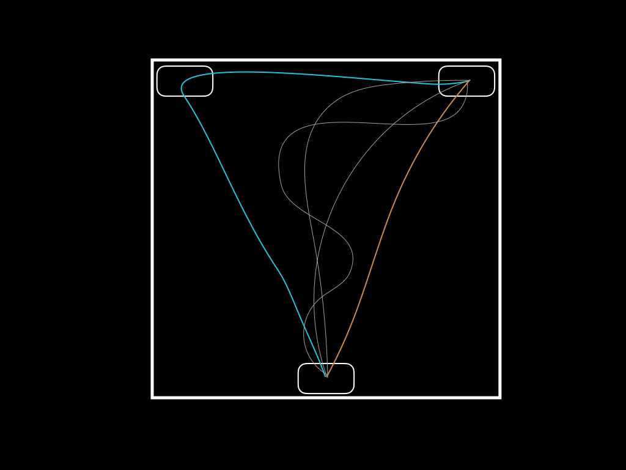
What is mouse tracking?
Introduction
https://doi.org/10.3758/s13428-018-01194-x
Answers questions about conflict (resolution)

Slide 4
Introduction
Case cues for sentence processing
Der Hase frisst…
‘TheSUBJ hareSUBJ eats…’
Den Hasen frisst…
‘TheOBJ hareOBJ eats…’
Kamide et al., (2003)

Slide 5
Visual cues for sentence processing
Introduction
Put the apple on the towel in the box
Tanenhaus et al., (1995)

Slide 6
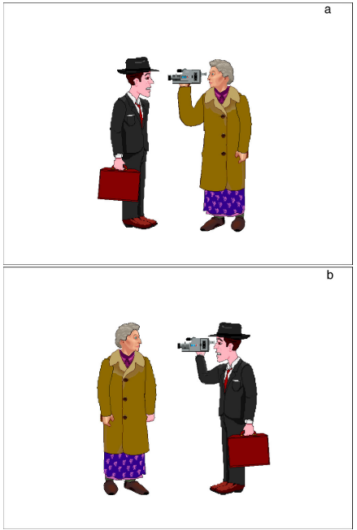
Cue conflict: case vs. visual cues
Introduction
Die Oma filmt den Mann
SVO
Die Oma filmt der Mann
OVS
‘visual’ preference
Knoeferle & Crocker (2005)
DV: word-by-word reading times

Slide 7
Research questions
Introduction
Can we measure thematic-role prediction with mouse tracking?
How are visual and case cues integrated for anticipatory thematic-role assignment?

Slide 8
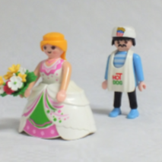
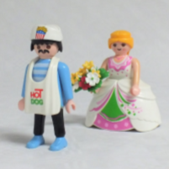
Design
Introduction
Task: agent identification
Step 1 |  | Step 2
Visual Cue |  | Sentence Structure
Level | Example | Level | Example
Match |  | Subject-extracted (SOV) | Das ist der Koch, der die Braut verfolgt. ‘This is the cook who is following the bride.’
Mismatch |  | SR
Match |  | Object-extracted (OSV) | Das ist der Koch, den die Braut verfolgt. ‘This is the cook whom the bride is following.’
Mismatch |  | OR

Slide 9
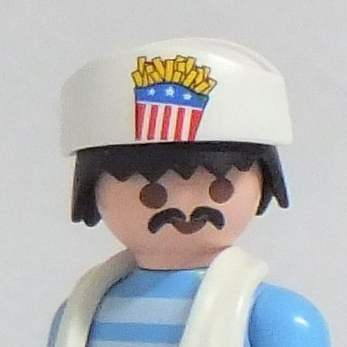
Procedure
Methods
Participants:
n = 69
Age = 18-50
L1 German
+
Task:
Click on the character
performing the action
verfolgen
Mouse (x, y, t)
Accuracy
Total RTs
Slide 1
Slide 2

Slide 10
Experimental script in E-Prime
Methods
User-friendly
Cost
Support
Data loss
e.g., only works on Windows OS

Slide 11
Experimental script in E-Prime
Methods

Slide 12
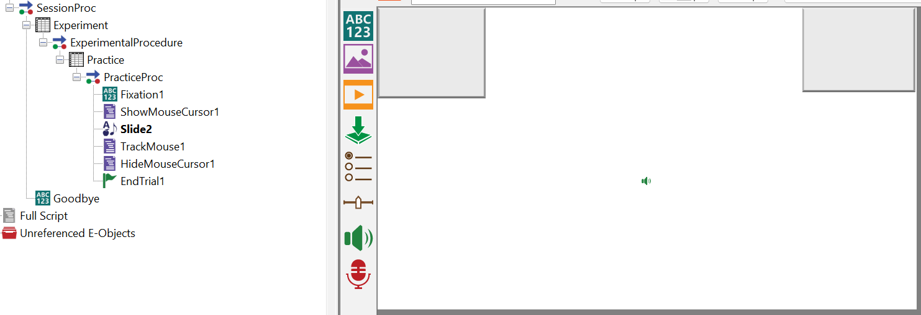
Experimental script in E-Prime
Methods

Slide 13
Experimental script in E-Prime
Methods

Slide 14
Administering with E-PrimeGO
Methods
User-friendly
Cost
Support
Data loss

Slide 15
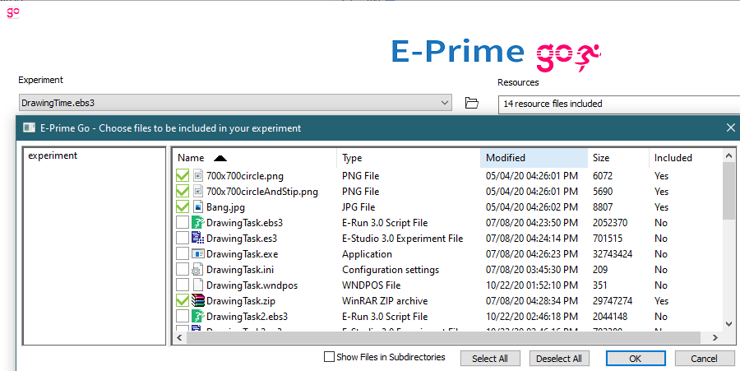
Administering with E-PrimeGO
Methods

Slide 16
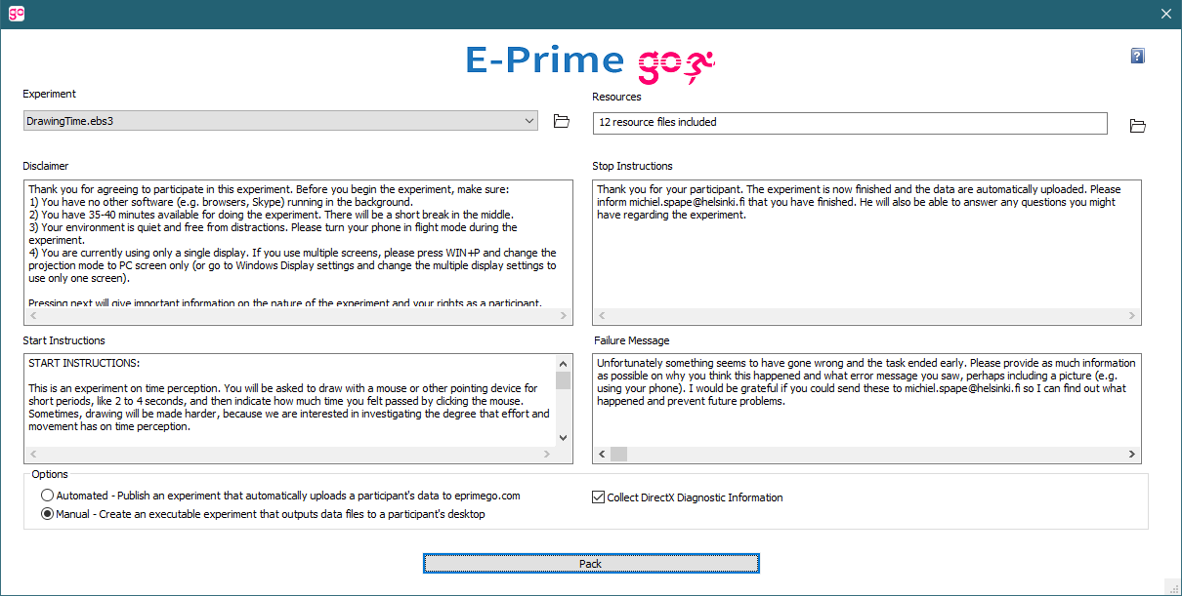
Administering with E-PrimeGO
Methods

Slide 17
Administering with E-PrimeGO
Methods

Slide 18
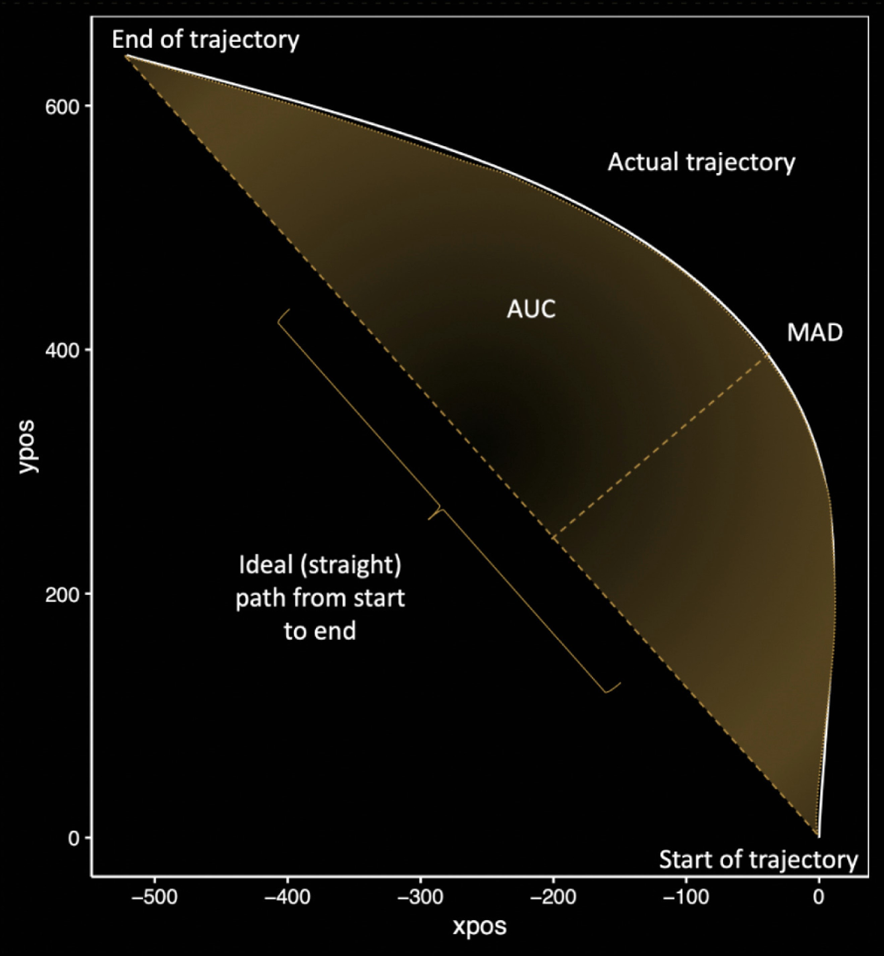
Data analysis with mousetrap
Methods
https://doi.org/10.1016/j.chb.2020.106453

Slide 19
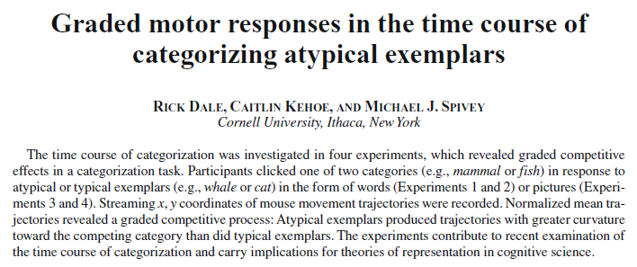
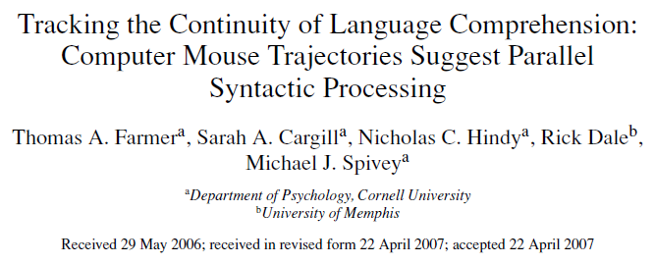
Modelling change over time
Methods

Slide 20
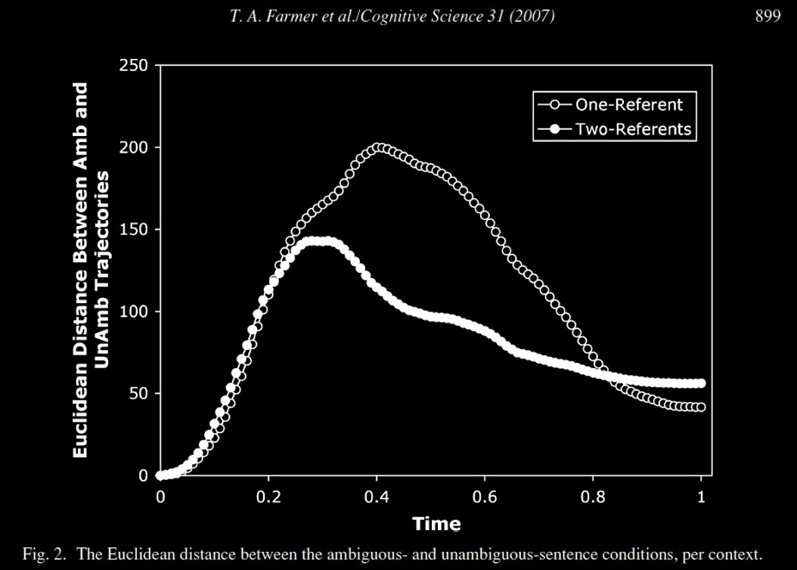
Modelling change over time
Methods

Slide 21
The problems of aggregation
Methods
from Wulff et al., 2019

Slide 22
Methods
Some thoughts on the data
Non-independence of observations/autocorrelation
Physical constraints
Multiple comparisons, multiple DVs
(Residual) distribution?
Homoscedasticity
i.e., are the variances independent of the means?

Slide 23
Analyses of time-series data
Methods
Cluster-based permutation testing (Maris & Oostenveld, 2007)
Determines WHETHER there is an effect
NOT WHEN
Bootstrapped divergence-onset times (Stone et al., 2021)
Determines WHEN there is an effect
NOT WHETHER
Non-parametric tests for non-normally distributed data

Slide 24
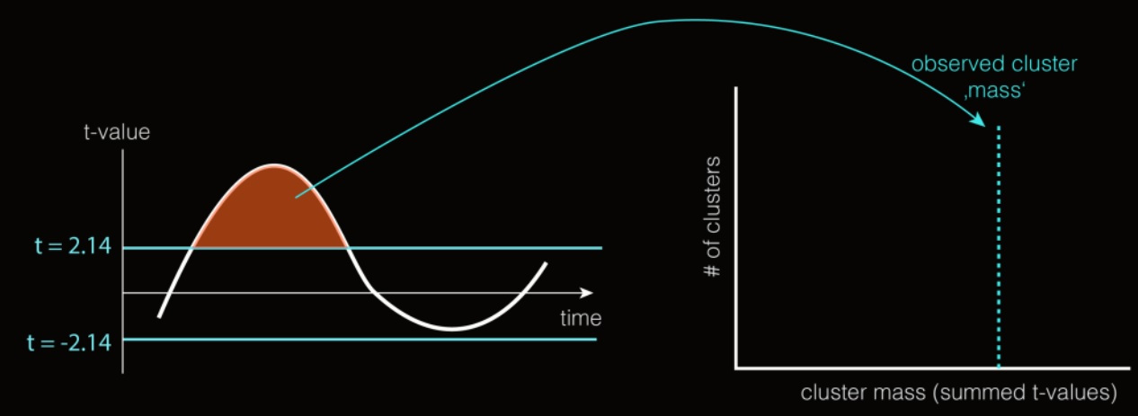
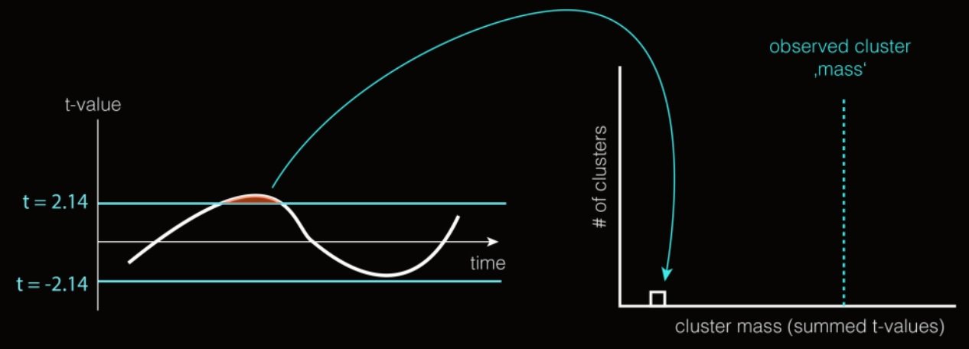
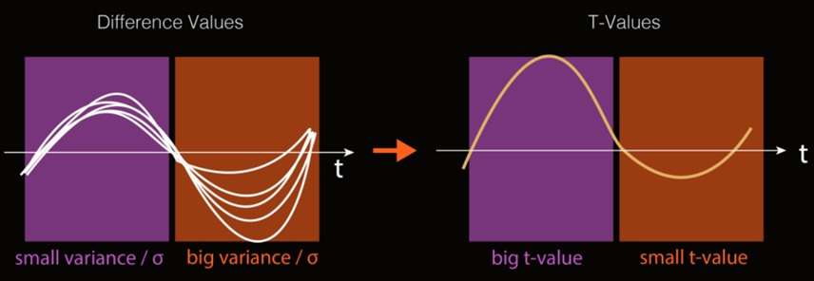
Cluster-based permutation testing
Methods
H₀: interchangeability of condition labelling
from: https://benediktehinger.de/blog/science/statistics-cluster-permutation-test/

Slide 25
Bootstrapped divergence-onset times
Methods
Geared towards eye-tracking data analysis
Bootstrapping:
Collect data
Resample data
Assess significance
Repeat 1000x

Slide 26
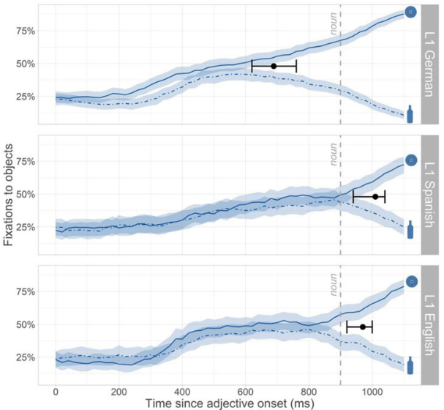
Bootstrapped divergence-onset times
Methods
H0: 50%

Slide 27
Design
RECAP
Task: agent identification through mouse click
Step 1 |  | Step 2
Visual Cue |  | Sentence Structure
Level | Example | Level | Example
Match |  | Subject-extracted (SOV) | Das ist der Koch, der die Braut verfolgt. ‘This is the cook who is following the bride.’
Mismatch |  | SR
Match |  | Object-extracted (OSV) | Das ist der Koch, den die Braut verfolgt. ‘This is the cook whom the bride is following.’
Mismatch |  | OR

Slide 28
Hypotheses
RECAP
Condition | Visual Cue | Das ist der NP | RelPron | Violation
SOV Match |  |  | der | none
SOV Mismatch |  |  | der | ‘visual’ preference
OSV Match |  |  | den | ‘visual’ + ‘subject-first’ preference
OSV Mismatch |  |  | den | ‘subject-first’ preference

Slide 29
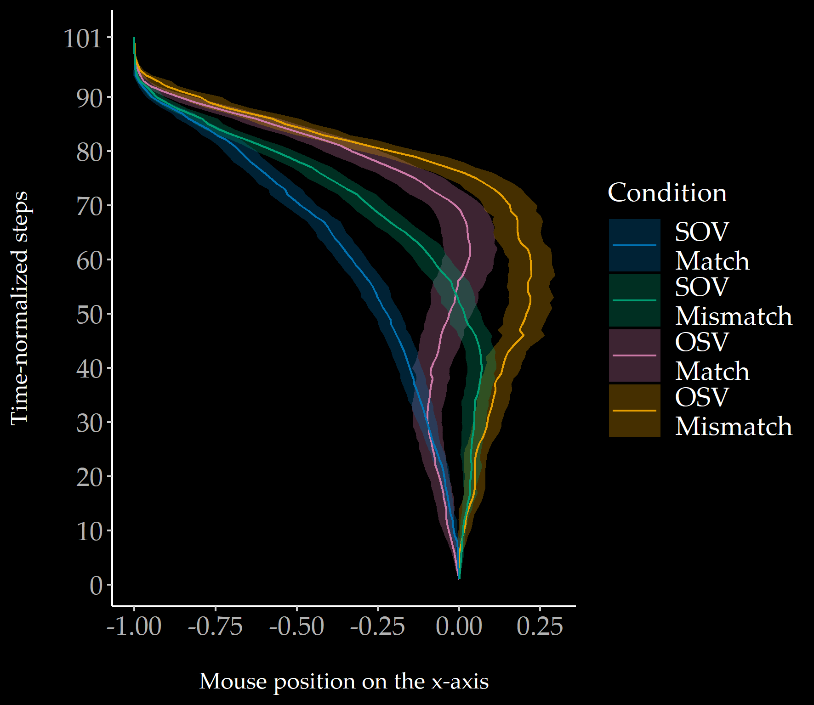
Results
Sentence Structure
(p = .001)
Visual Cue
(p = .001)
Cluster-based permutation

Slide 30
Results
Bootstrapped divergence-onset times

Slide 31
Results
Bootstrapped divergence-onset times

Slide 32
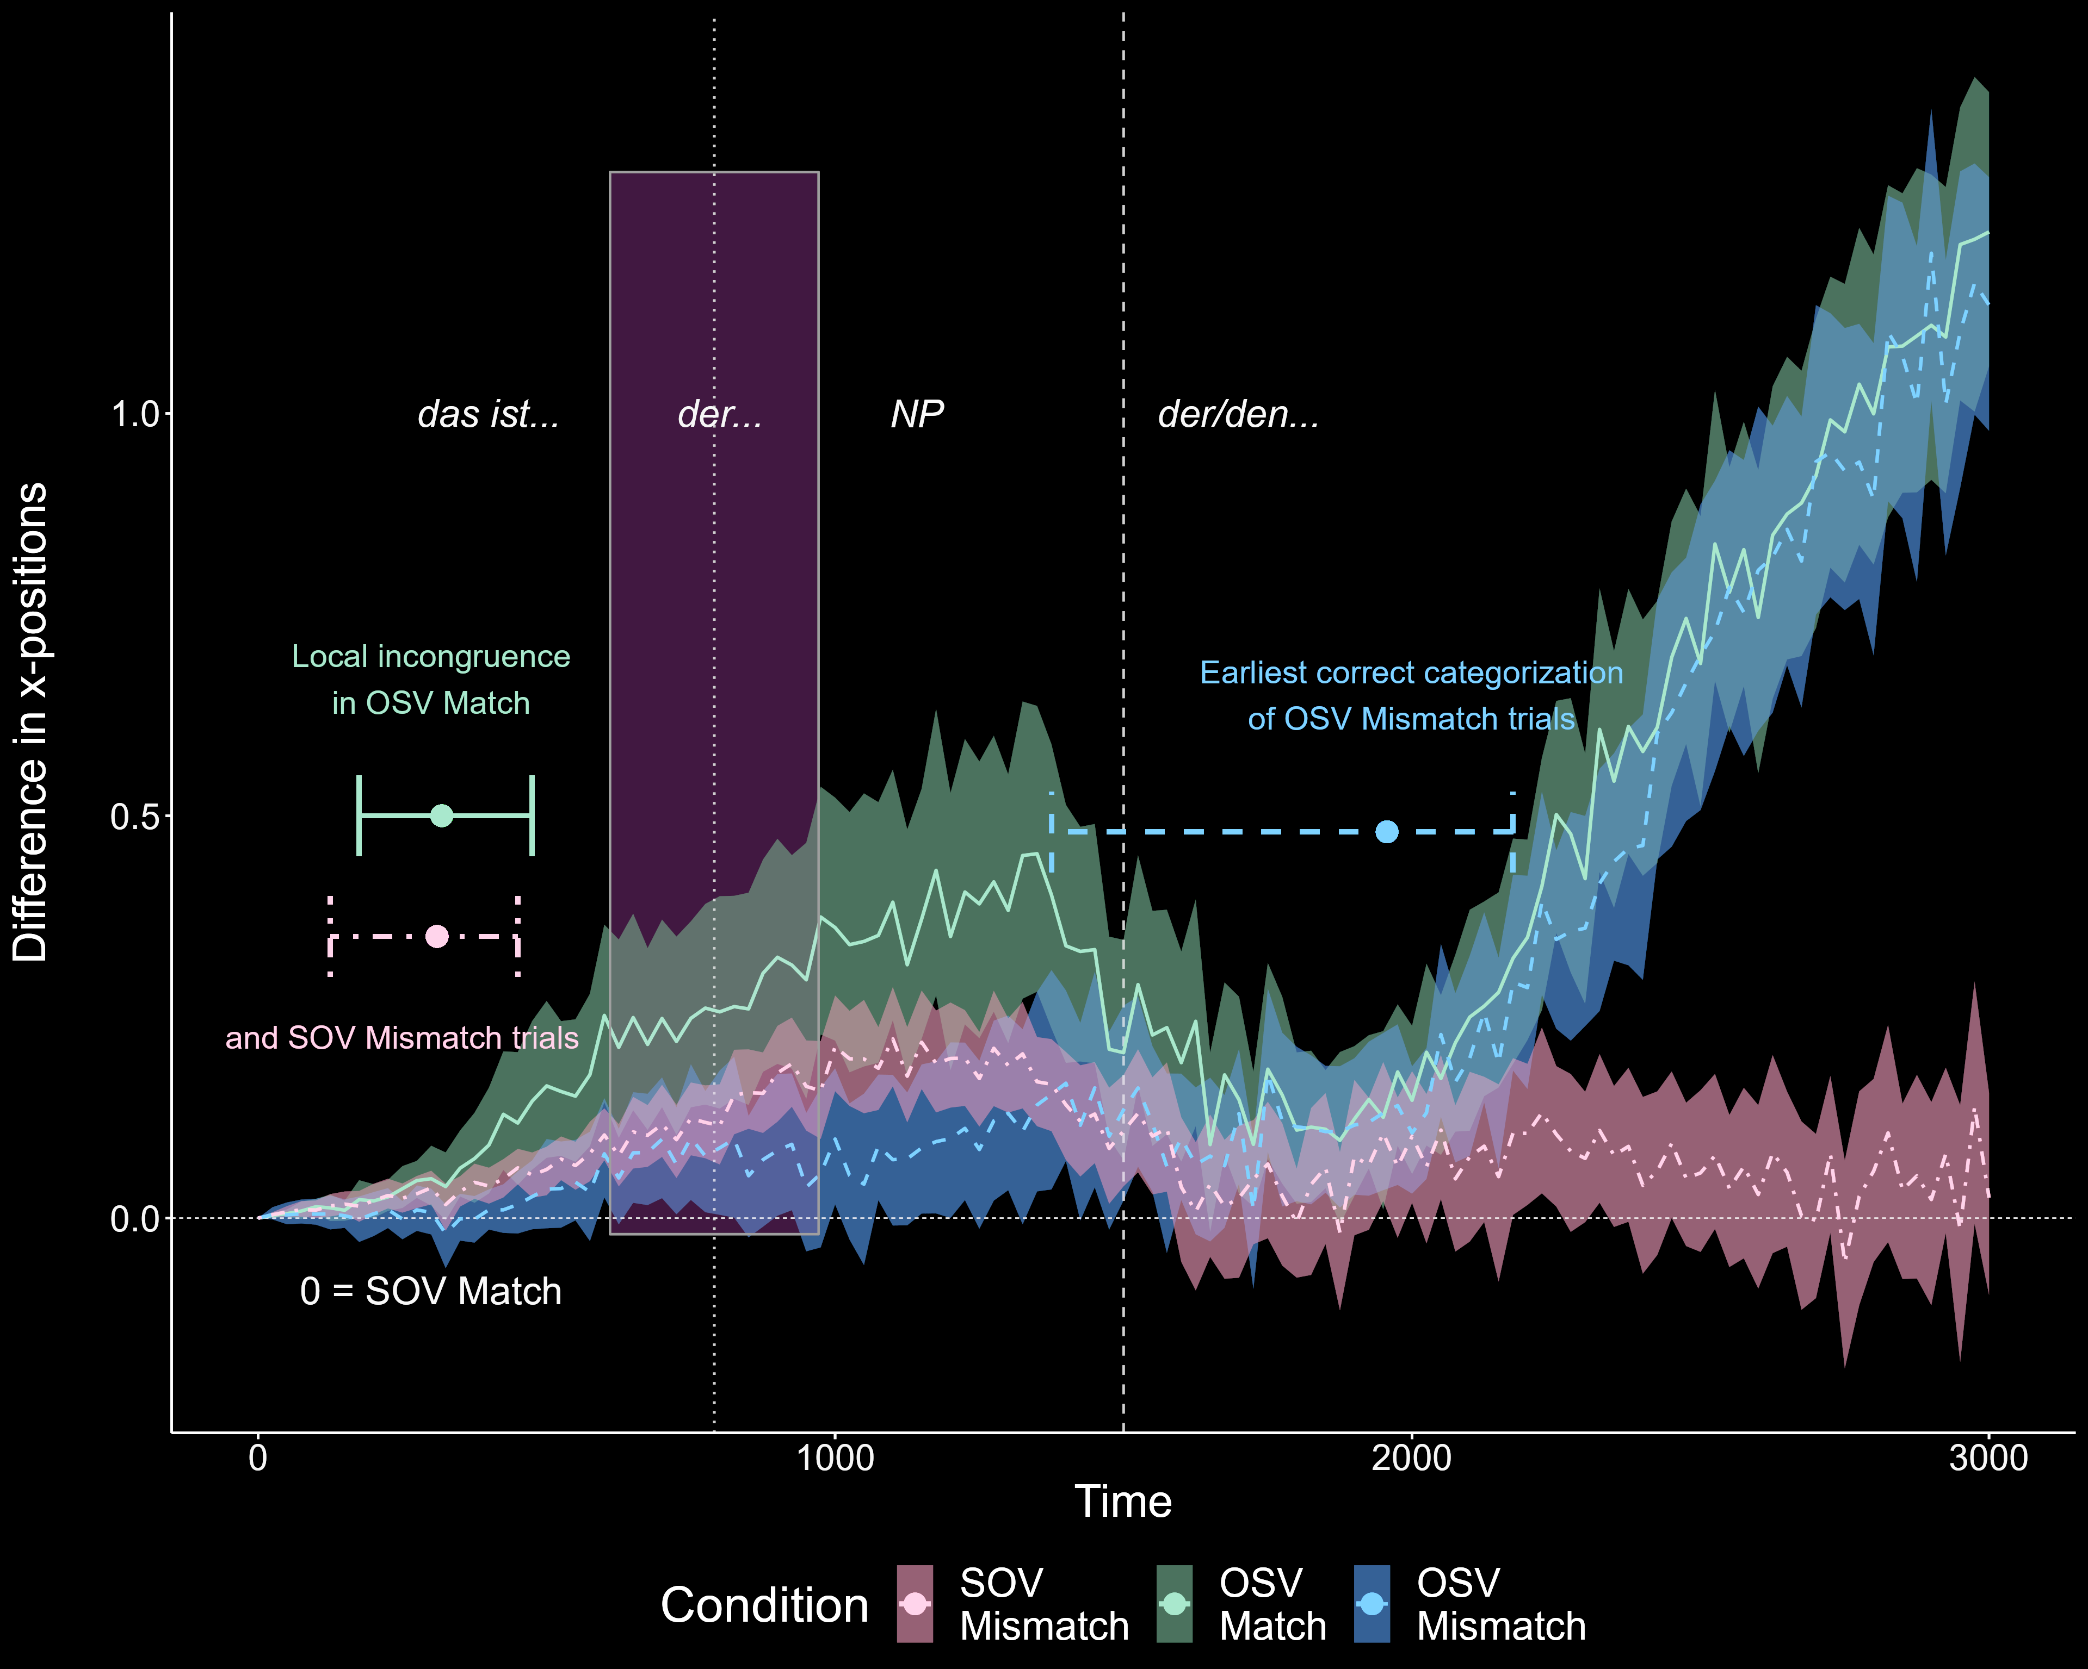
Results

Slide 33
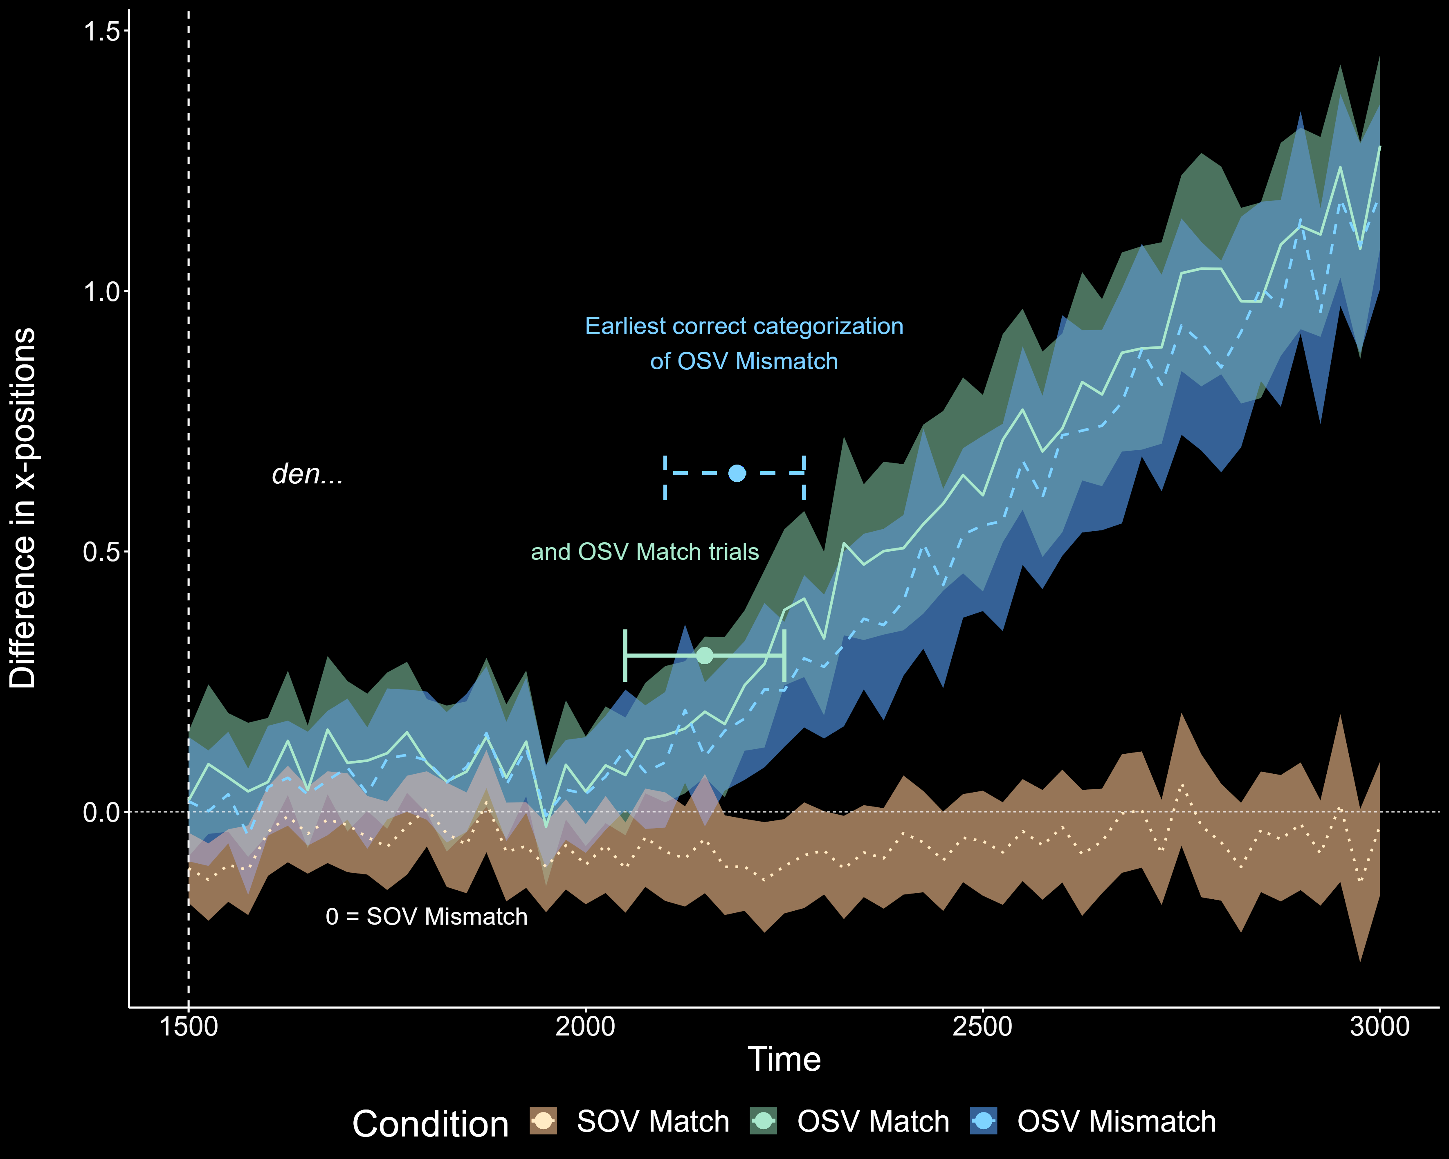
Results

Slide 34
Summary and conclusions
Conclusions
Can we measure thematic-role prediction with mouse tracking?
Yes
Not with incongruent visual cues
How are visual and case cues integrated for anticipatory thematic-role assignment?
‘Subject-first’ and ‘visual’ preferences are integrated on-line and they influence thematic-role predictions
After disambiguation, the effects of ‘visual’ preference disappear

Slide 35
Thank you!
Questions?
zona@uni-potsdam.de

