Slide 1
Notes:
Hello everybody and thank you for joining today
I’m gonna talk about our project, on the weighting of visual and linguistic cues for sentence comprehension, my co-author and I have taken a lifespan perspective on this one

Slide 2
Notes:
So, we know that to understand language, speakers integrate different types of cues, some are structural, so for instance syntax and morphosyntax, and some other cues are non-structural, for instance semantics and visual cues

Slide 3
Notes:
What we know about the use of visual cues for sentence processing comes mainly from the visual world eye tracking paradigm, in which eye movements are used as an index of language processing. This research has found that language guides attention to the visual displays, and in turn, visual displays affect processing of ambiguous language, and the tasks in this paradigm are often passive listening to instructions or sentence-picture verification

Slide 4
Notes:
However, the choice of these experimental tasks and the use of ambiguous language make the visual cues particularly relevant to complete the task successfully, or make the speaker perceive them as highly relevant. In addition, the visual displays that are presented are typically compatible with at least one of the possible interpretations of the linguistic materials, so if both visual and linguistic cues convey the same or compatible representations, it is difficult to disentangle the degree to which each cue type is determining comprehension. In order to do this, we should consider situations in which both cue types are in conflict.

Slide 5
Notes:
What we know about conflict between cues comes from the dual-route approach to comprehension, according to which speakers can derive meaning along two parallel routes. On the one hand, structural cues can be analysed and decoded ‘algorithmically’, i.e., strictly following the syntactic rules of the language. On the other hand, speakers can derive meaning along an inference-based route, that makes use of non-structural cues such as semantics, pragmatics, and of interest for us, visual cues.

Slide 6
Notes:
Crucially, the meanings that are derived according to one or the other route might be at odds with each other, and this research has shown that the inference-based route is more likely to be endorsed in the presence of more complex language and when non-structural cues support the misinterpretations. However, this research has only focused on linguistic non-structural cues, but not visual information.

Slide 7
Notes:
So, this is where the lifespan perspective becomes interesting. Healthy aging can be used as a testbed for dual-route mechanisms because there is evidence that some aspects of language decline with increasing age, such as lexical retrieval, while there is some controversy on whether aging affects syntactic abilities. On the one hand, there is evidence against syntactic parsing declines, on the other hand, highly complex language has been found to be more problematic to process at old than at a young age.

Slide 8
Notes:
Instead, there is evidence that meaning-based reasoning remains stable and the use of semantic and pragmatic cues might even become more prominent with increasing age. We don’t know a lot on visual cues and aging, but there is evidence that visual cues can be used during language processing at old age, but the timing and nature of the effects of visual information undergo change with aging.

Slide 9
Notes:
So, taken together, this evidence has been interpreted as a ‘syntax to semantics’ shift that happens as a function of increasing age, in which basically syntactic parsing becomes less prominent and instead semantic and pragmatic cues are used more and more by older speakers.

Slide 10
Notes:
Ok, but why does this shift happen? There are two main hypotheses that are relevant to this study.

Slide 11
Notes:
So we know that healthy aging affects processing capacities, and if we think that increasing structural complexity increases cognitive demands, we could conclude that reliance on non-structural cues would facilitate computationally intense processing and be helpful for comprehension.

Slide 12
Notes:
On the other hand, there is evidence that older people encode more additional information compared to younger adults, alongside task-relevant information, which has led researchers to propose that this enriched encoding increases vulnerability to interference from additional non-structural information.

Slide 13
Notes:
So in this study we asked the following questions. First, How are visual and morphosyntactic cues integrated to shape mental representations, and we hypothesized that, on the one hand, speakers might rely on morphosyntax with little effect of the visual cues, unless syntactic parsing becomes challenging. On the other hand, based on all the evidence for the role of visual cues on interpretation of ambiguous language, we might also hypothesize that visual cues would be relied on regardless of ambiguity and/or of linguistic complexity.

Slide 14
Notes:
Second, we ask whether the weighting of visual vs. morphosyntactic information changes with age, and here we hypothesized that YES, older participants might rely more on visual cues, based on the syntax to semantics shift, and the present design allows us to distinguish between both hypotheses as to the reasons underlying it. Namely, if processing demands become higher for older people due to processing limitations, we would observe higher reliance on visual cues accompanied by comprehension declines with increasing age. However, if visual cues are more strongly encoded by older than younger adults, we would observe that comprehension should only decline when visual cues are presented and be equally accurate in lack of visual cues.

Slide 15
Notes:
So, in our design we manipulated the structure of spoken relative clauses in German, the subject-relative clause being unmarked and easier to process, introduced by who, and the object-relative clause is a marked structure which is more difficult process, introduced by the pronoun whom.

Slide 16
Notes:
We presented these sentences in isolation, for the baseline condition, or alongside visual cues that either represented the same action direction conveyed by the sentence, in the matching condition, or the opposite action direction in the mismatching condition. I will show you examples in a moment. In the analyses, we compared match to baseline and mismatch to baseline, with the hypothesis that matching visual cues would increase and mismatching cues would decrease comprehension accuracy.

Slide 17
Notes:
Our dependent variables were accuracy and latency of responses to binary agent identification questions.

Slide 18
Notes:
So, these were our participants, we had 148 native speakers of German, 97 women and 51 men, who were screened for mild cognitive impairment

Slide 19
Notes:
And here is an example of the procedure: on the first slide, participants saw either a fixation cross in the baseline condition, or one of these pictures, and at the same time we presented the spoken sentences, for instance in this case the sentence would either be “this is the cook WHO follows the bride” or “this is the cook WHOM the bride follows”, and as you can see in German these sentences differ only for one letter on the pronoun. On the second slide, participants answered a question to the effect of “is the bride being followed” or “is the cook being followed” and pressed a button to answer yes or no.

Slide 20
Notes:
And these are our results, so we start with the first question on the integration of visual and linguistic cues. This is accuracy rates,

Slide 21
Notes:
And we observed a main effect of sentence, with subject relatives having higher accuracy than object-relatives as expected, and also main effect of visual cues, as expected matching cues increased accuracy compared to baseline, and mismatching cues decreased it.

Slide 22
Notes:
We also observed a significant interaction showing that the difference between both sentence types was larger in baseline than in mismatching trials, in contrast to the hypothesis that visual cues are relied on more with more complex language.

Slide 23
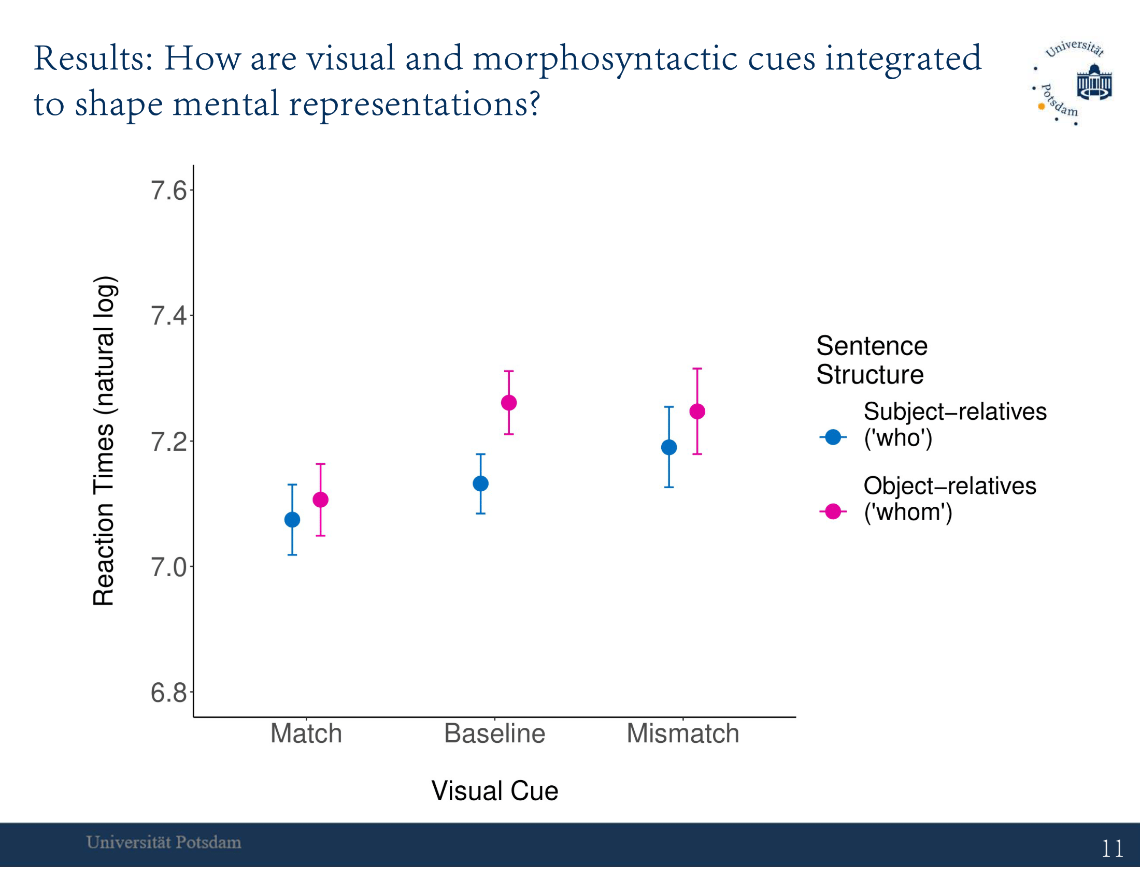
Notes:
The reaction time data shows a similar picture:

Slide 24
Notes:
we have a main effect of sentence, more complex sentences were responded to more slowly than less complex ones, and a main effect of mismatch, which increased reaction times compared to baseline

Slide 25
Notes:
Also here we found similar interaction patterns, showing that the difference between sentence types was larger in baseline than in both matching and mismatching trials.

Slide 26
Notes:
Coming to the second question on the lifespan changes,

Slide 27
Notes:
as I said we observed main effects of both matching and mismatching visual cues on accuracy

Slide 28
Notes:
but also we found a highly significant interaction of age by mismatch, indicating that increasing age was associated with larger accuracy decreases in mismatching than in baseline trials, as you can see from the graph.

Slide 29
Notes:
Zooming in on the effect of aging on each of our six conditions, we see that there is a significant effect of sentence structure overall, but we also observe that the effect of aging changes quite dramatically between conditions (and in fact there is no significant simple effect of age overall).

Slide 30
Notes:
In matching trials, we see that increasing age was associated with higher performance with the more complex sentences, which suggests that older participants benefited more from the matching visual cues than younger participants did.
In baseline trials, we can clearly see that increasing age was associated with smaller differences between sentence types, we even see a numerical increase in accuracy to the more complex sentences. More cautiously, rather than an accuracy increase, we interpret this result as morphosyntactic cues playing a smaller role for older than younger participants.
Then in mismatching trials, we see that accuracy rates decline quite steeply with increasing age. Here we expected more complex sentences to be particularly problematic for older adults in this condition, but actually we observe that the accuracy decline is significantly steeper with the less complex sentences. In part this could be due to the fact that performance was relatively low for object relatives at younger ages, too, but certainly seems to speak against the view that more complex sentences would be more problematic at older age.

Slide 31
Notes:
Finally, for the reaction time data across the lifespan,

Slide 32
Notes:
As I said, we observe a main effect of mismatching cues, which were responded to more slowly than baseline trials,

Slide 33
Notes:
but we also observe significant interactions showing that, in baseline trials, so without any visual cues, reaction times increased more with aging as compared to either matching or mismatching trials.

Slide 34
Notes:
Ok, so turning to the discussion, we found that visual cues are relied on regardless of structural ambiguity and complexity, and contrary to our hypotheses, that morphosyntax is relied on less when visual cues of any type are presented.

Slide 35
Notes:
As to the lifespan perspective, we did not find any evidence for declines in syntactic parsing ability, but we found evidence for an increased reliance on visual cues with increasing age. Also, we found that the presence of any visual cues yielded relatively faster responses with increasing age, and we tentatively explained this finding in terms of older adults having more problems with lexical retrieval than young adults, so visual cues might be facilitating lexical processing, and this would be more evident on older adults because younger adults don’t have any problems with

Slide 36
Notes:
To conclude, we found that visual cues can override unambiguous morphosyntactic cues in shaping mental representations, as per the dual-route approach to comprehension, and that the visual contribution is pervasive and not specific to conditions of higher cognitive demands, which expands on previous evidence from dual-route processing.

Slide 37
Notes:
As to the lifespan perspective, we found higher reliance on visual cues with increasing age which was not attributable to syntactic parsing difficulty in healthy aging, because we did not find any signs of difficulty in the absence of visual cues, and thus we interpret this finding in terms of increased vulnerability to interfering visual information on mental representations with increasing age.

